Slide 1
2004 Cross-shelf
28/11/2019

Slide 2
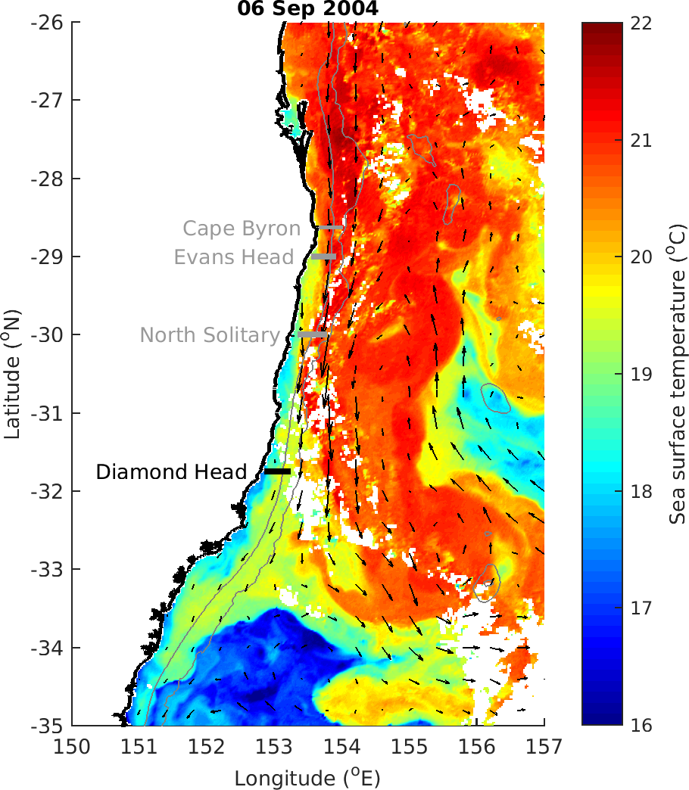

Slide 3
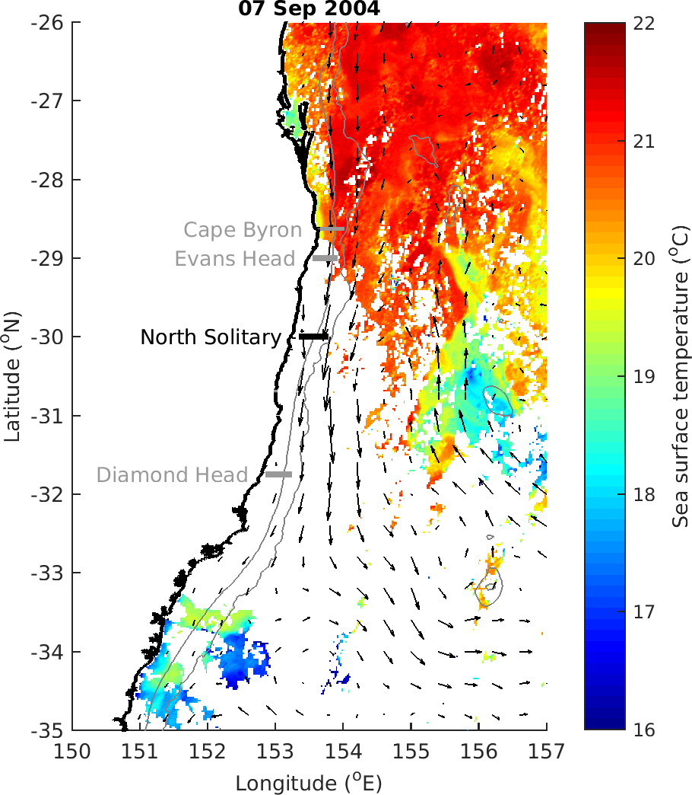

Slide 4
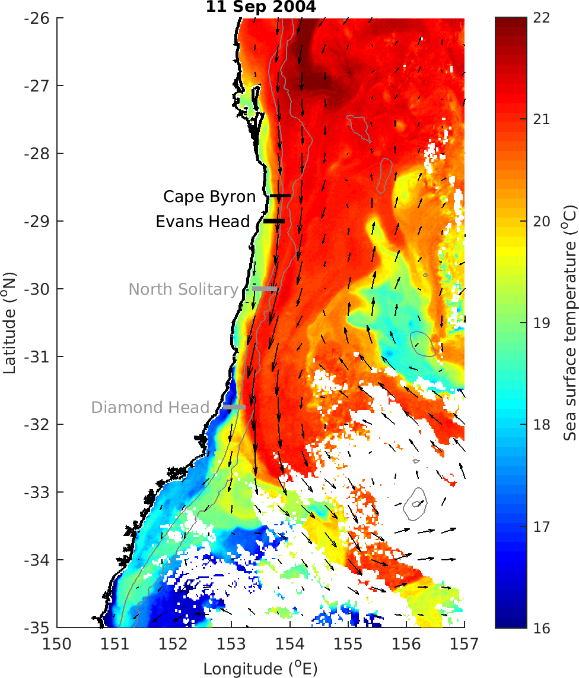

Slide 5
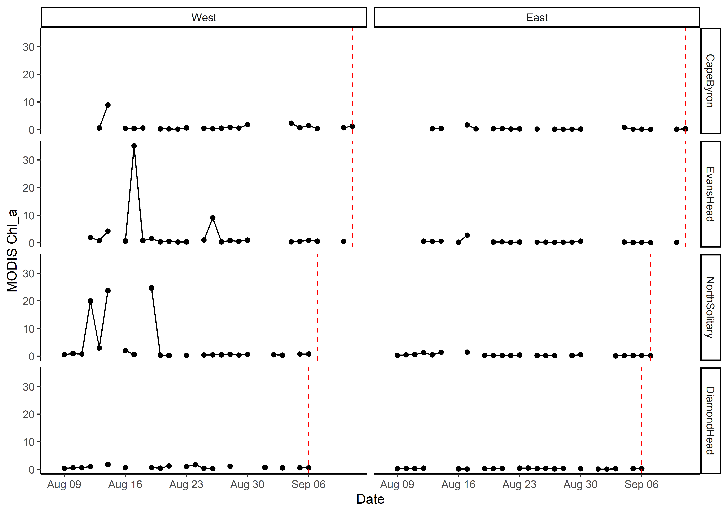
MODIS Chl_a

Slide 6
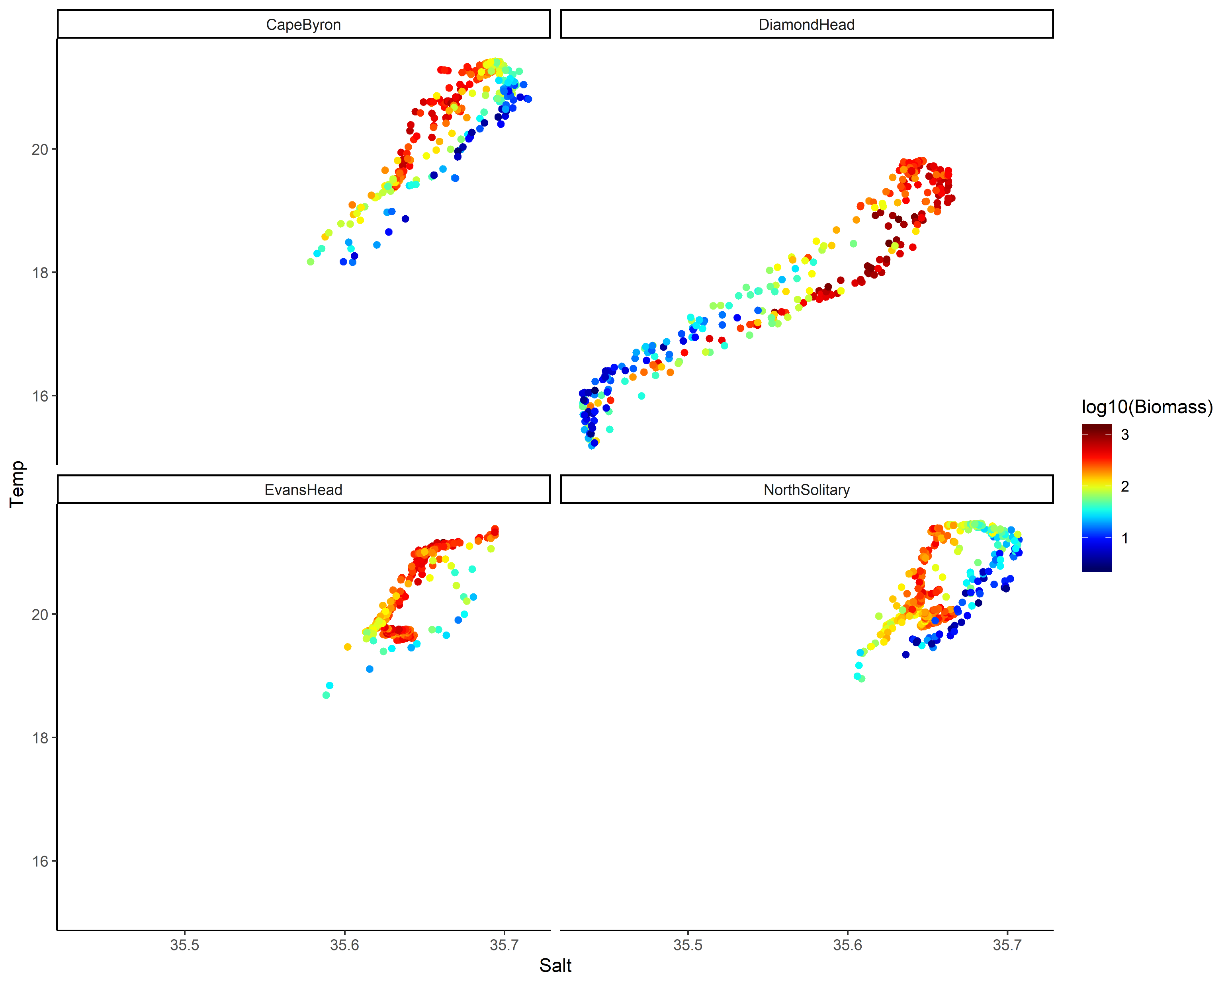
TS Plot by log₁₀(Biomass)

Slide 7
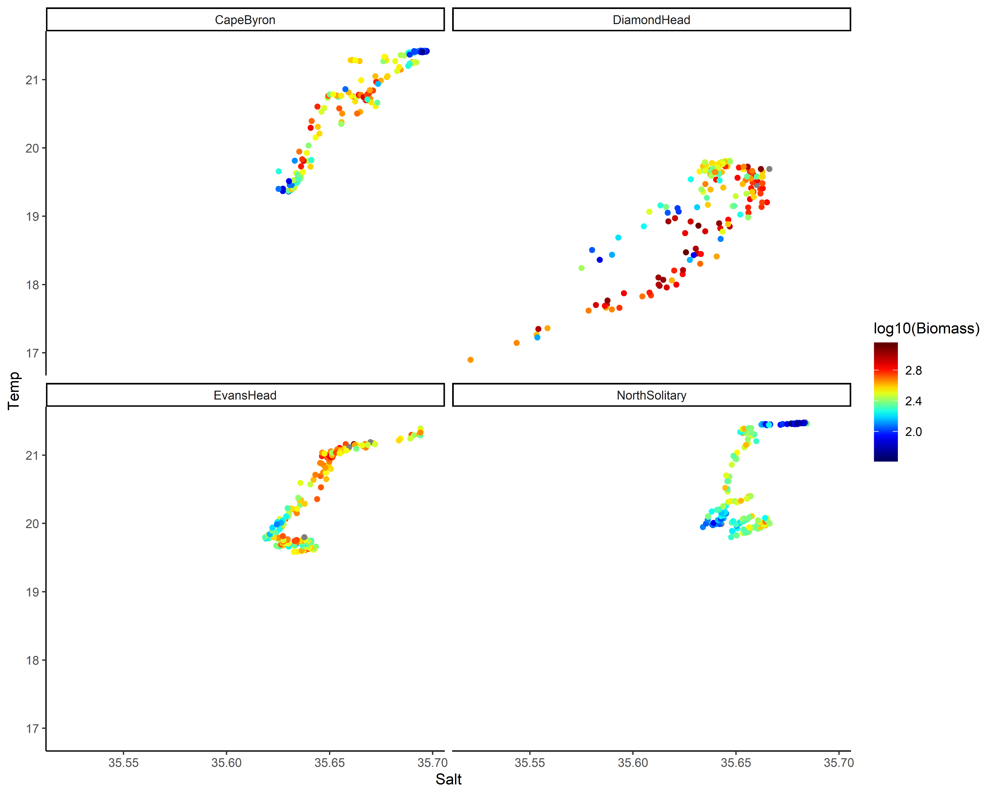
TS Plot by log₁₀(Biomass) top 50m

Slide 8
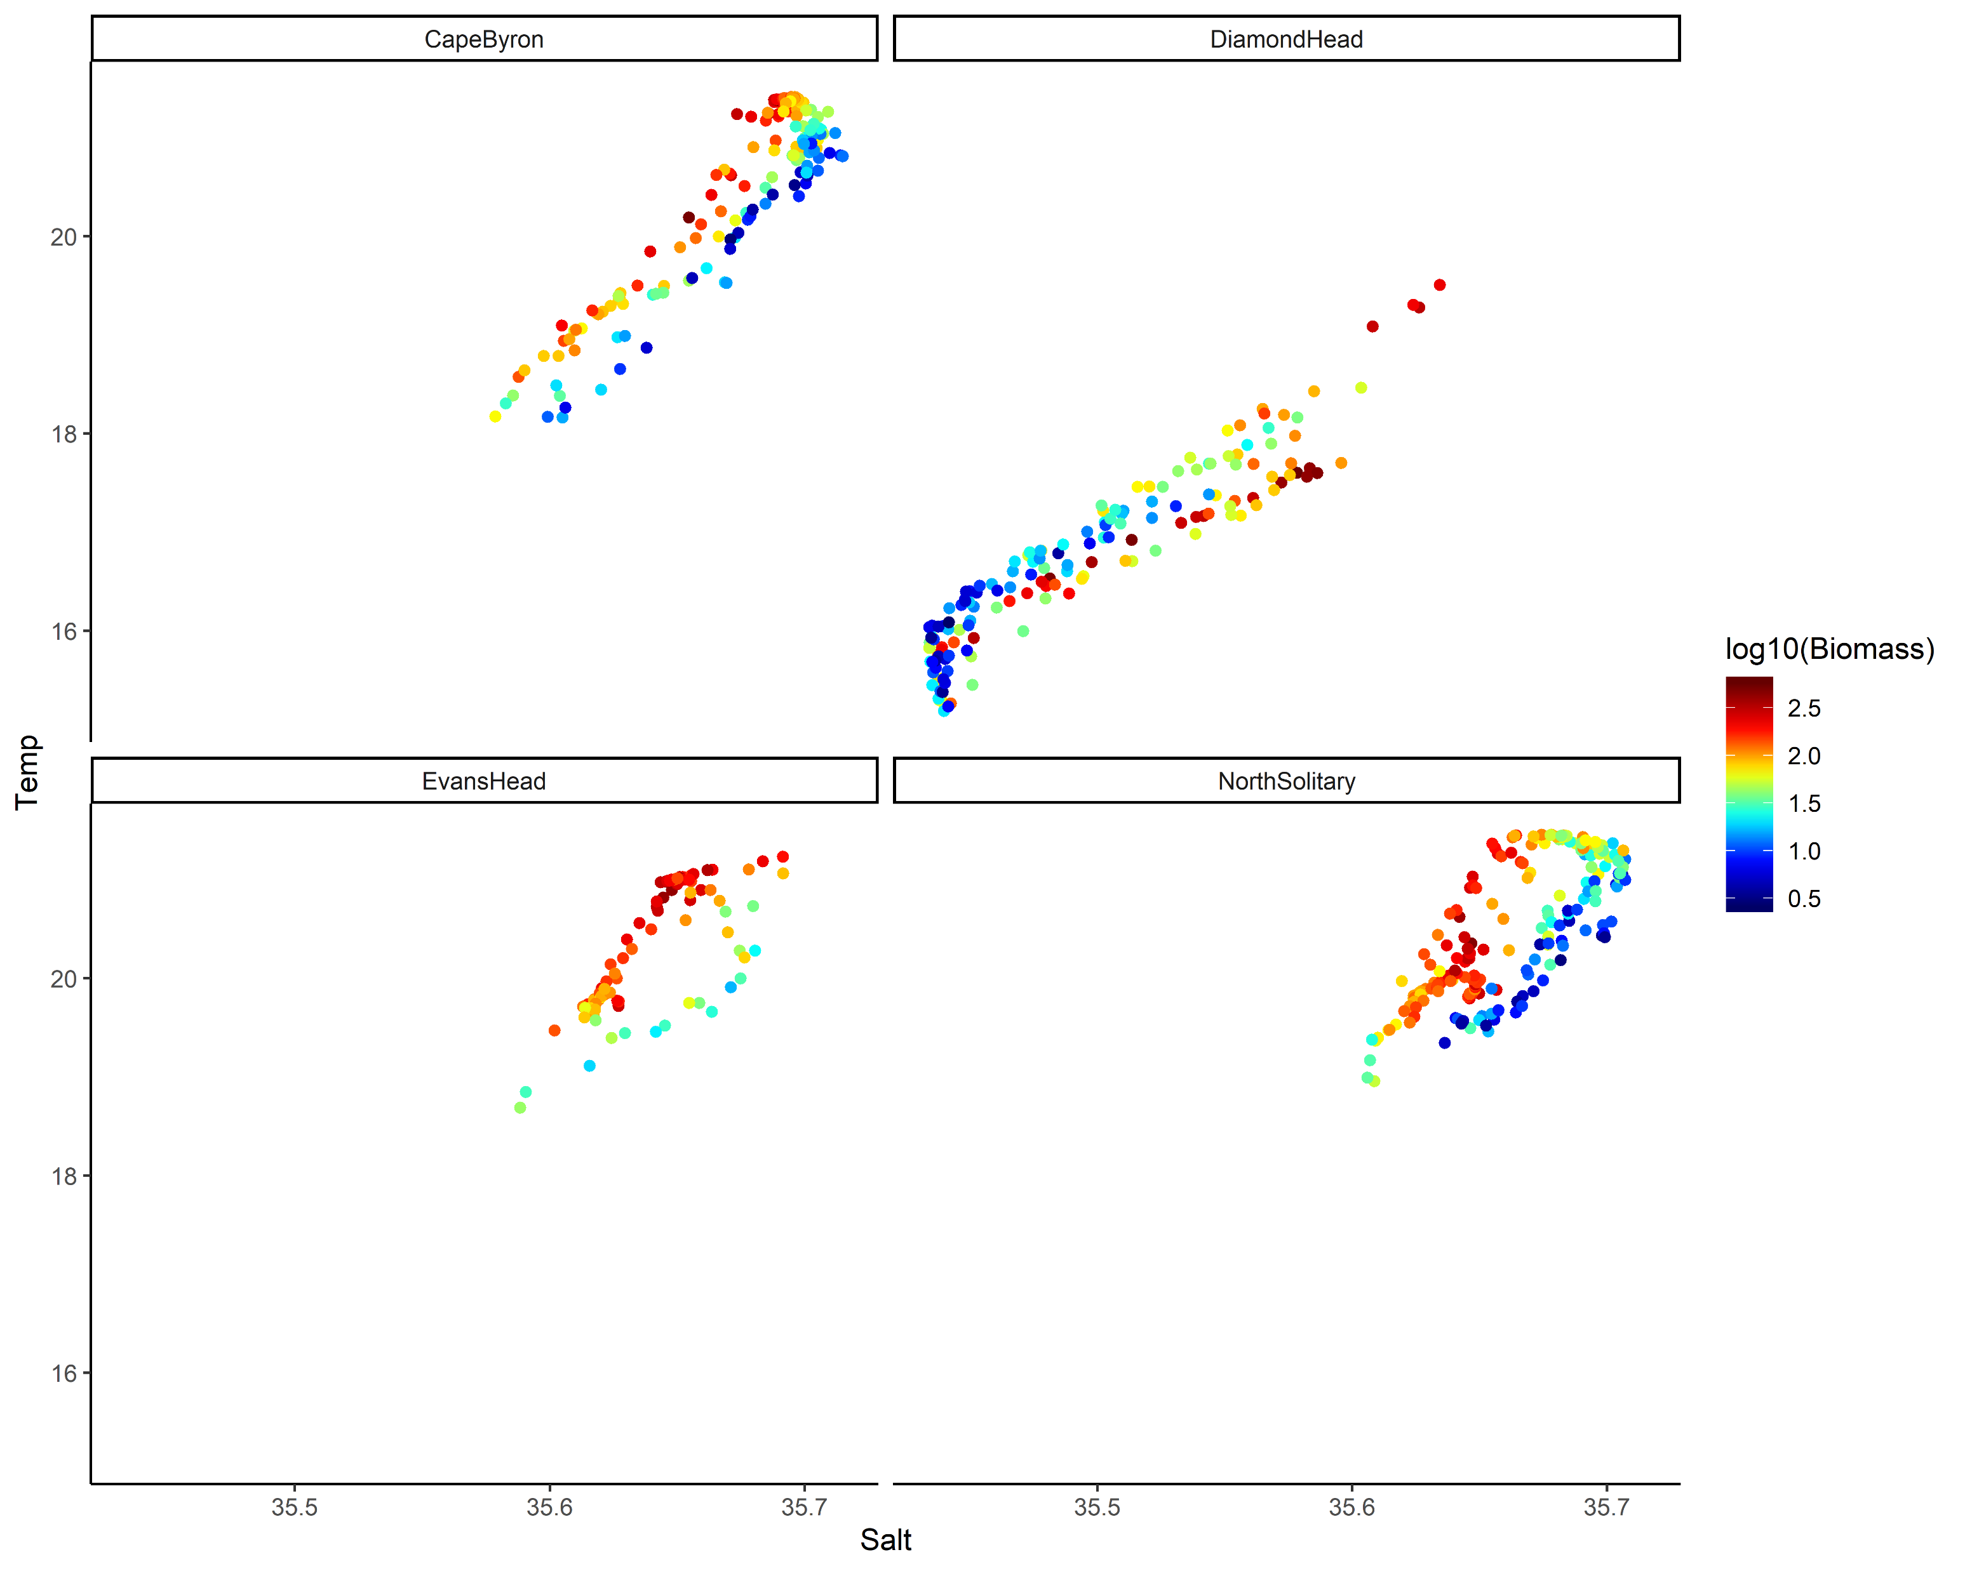
TS Plot by log₁₀(Biomass) below 50m

Slide 9
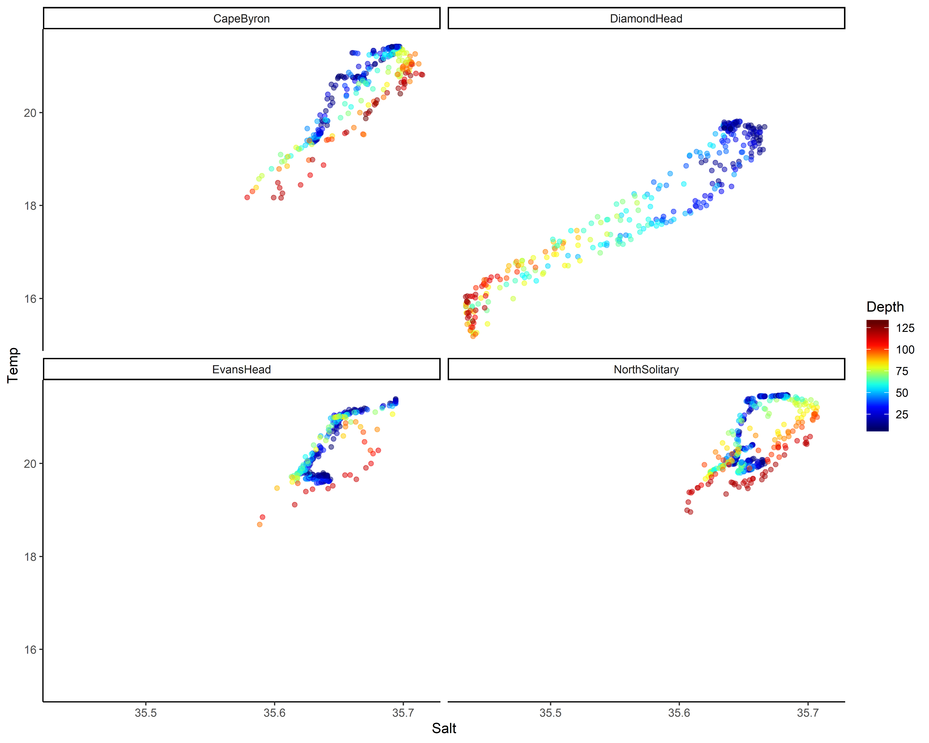
TS plot by Depth

Slide 10
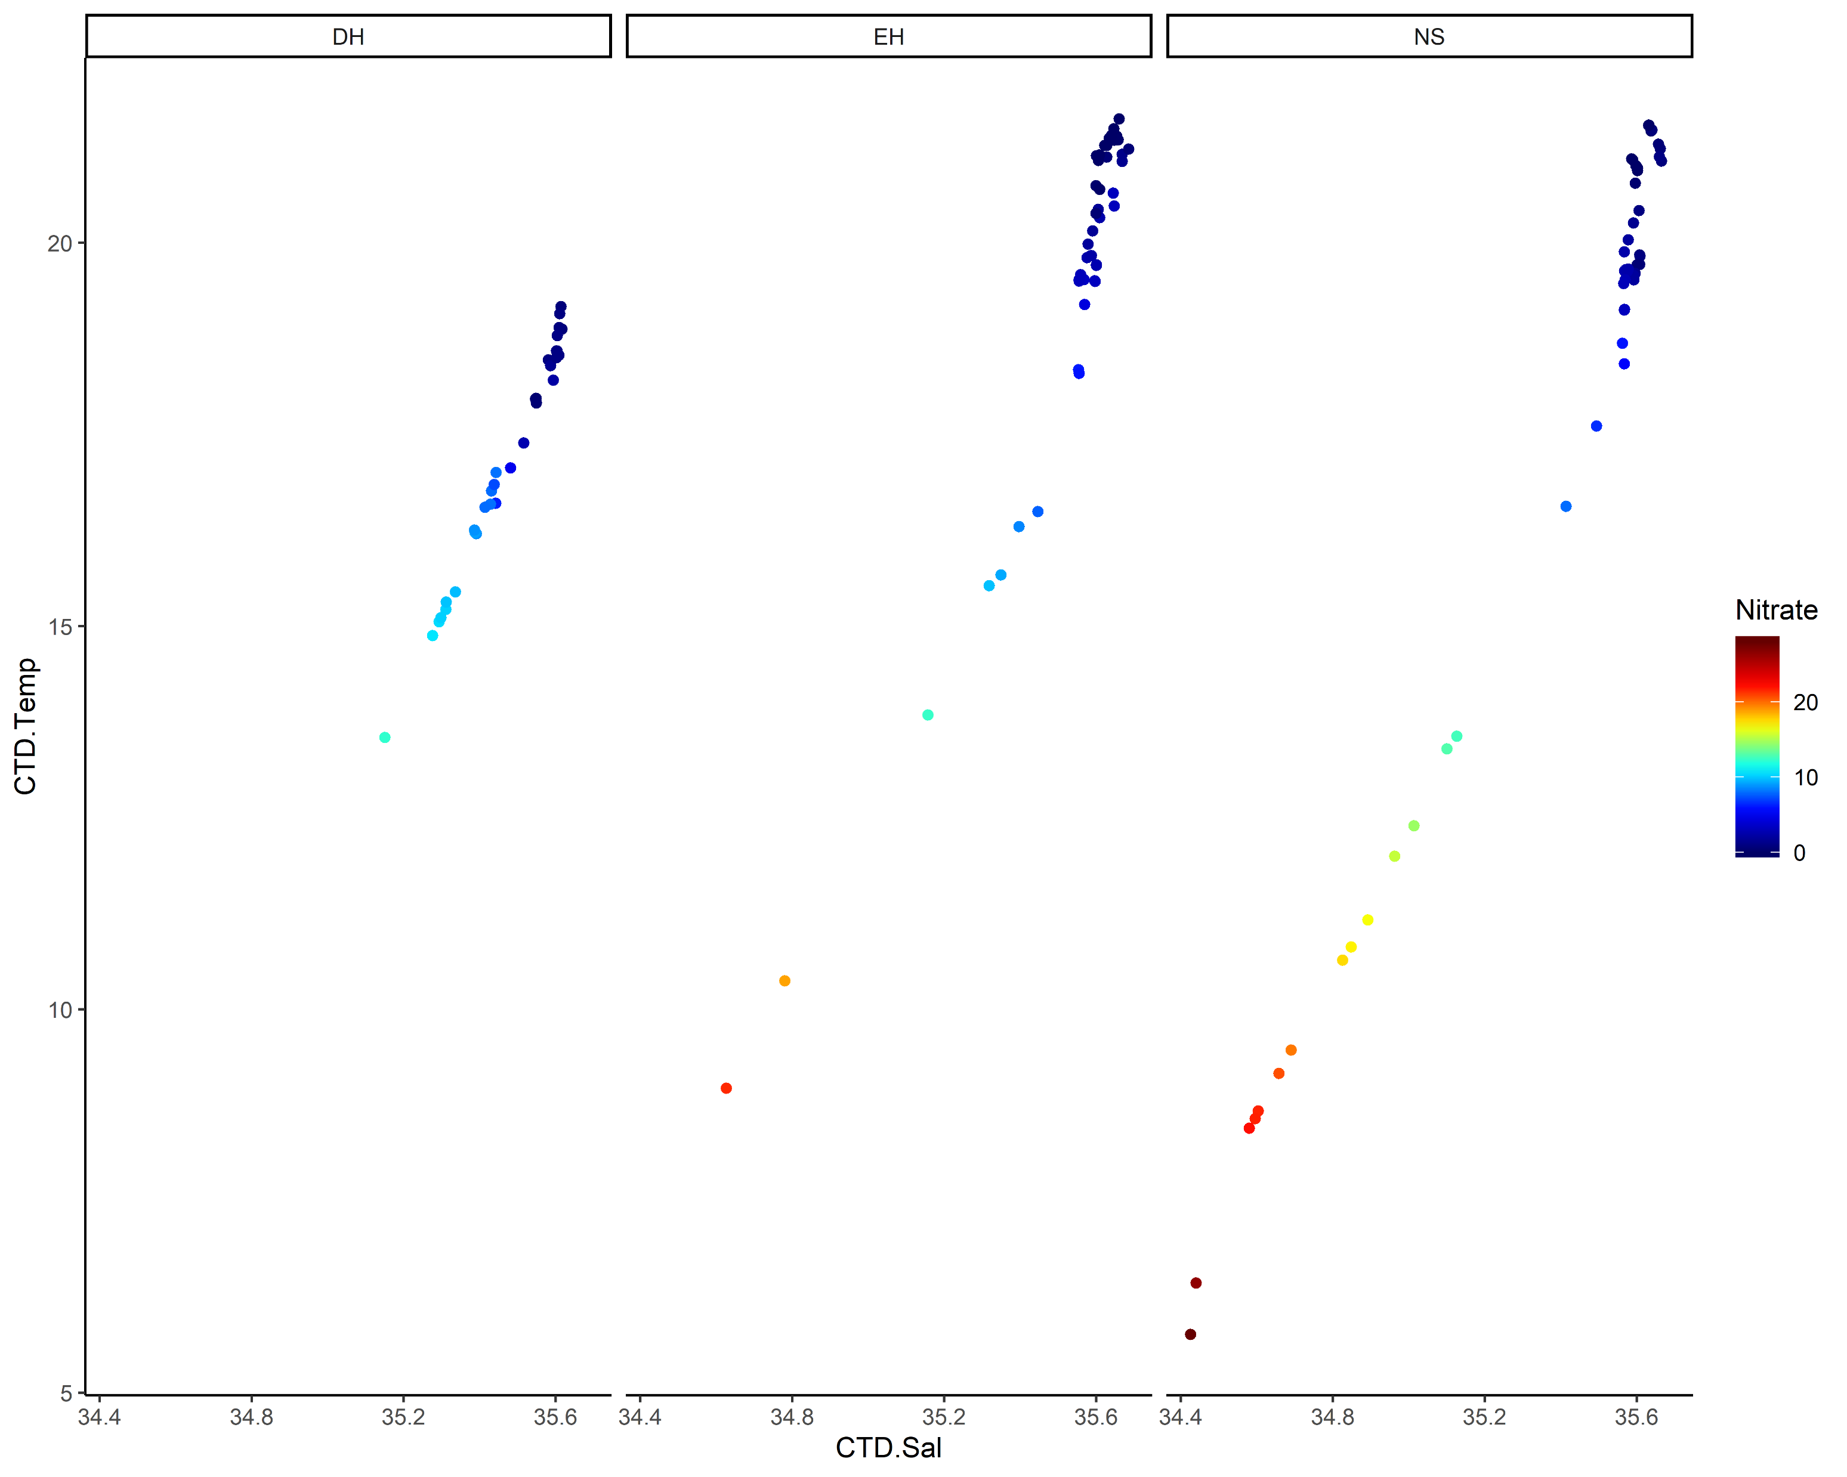
TS plot by Nitrate

Slide 11
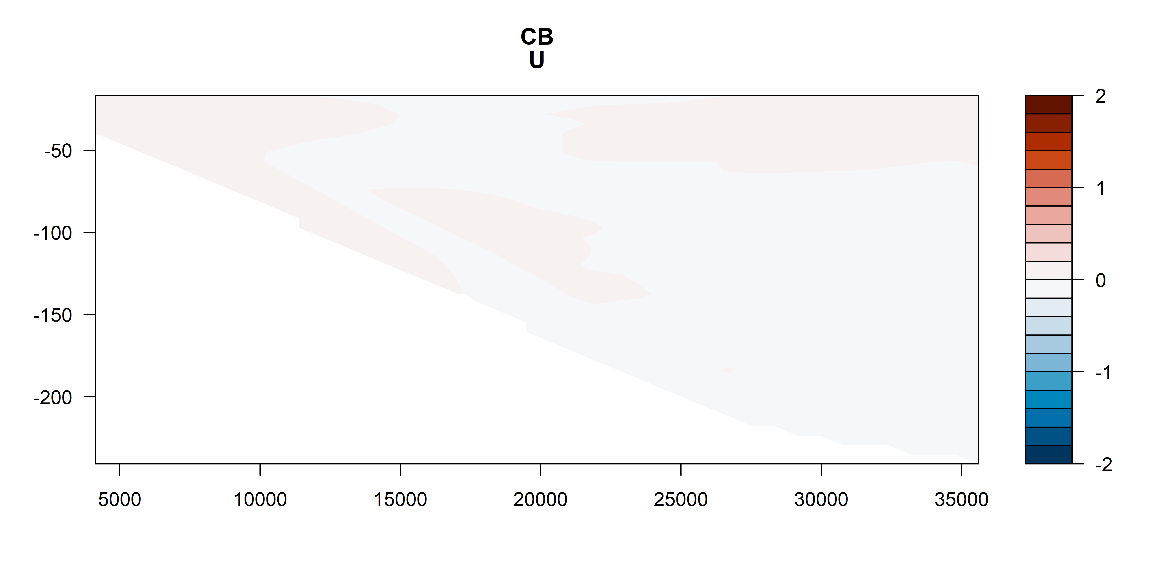
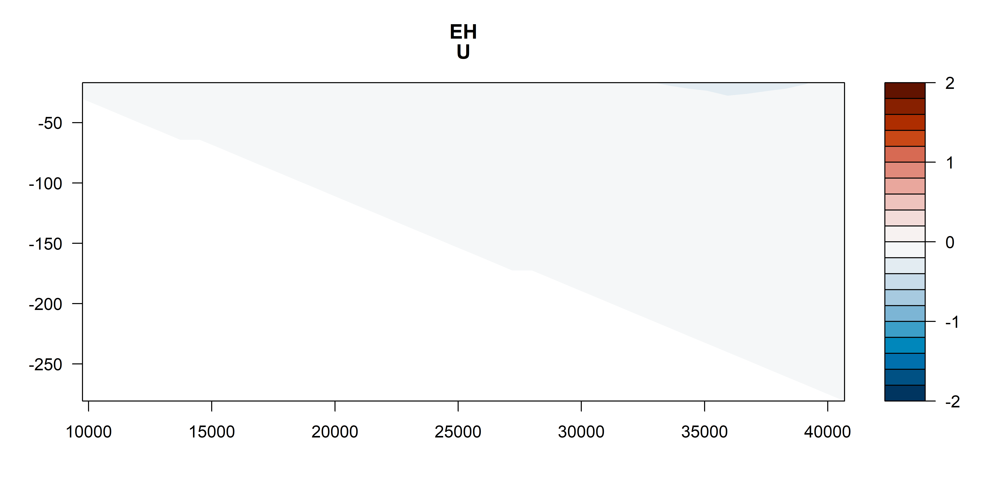
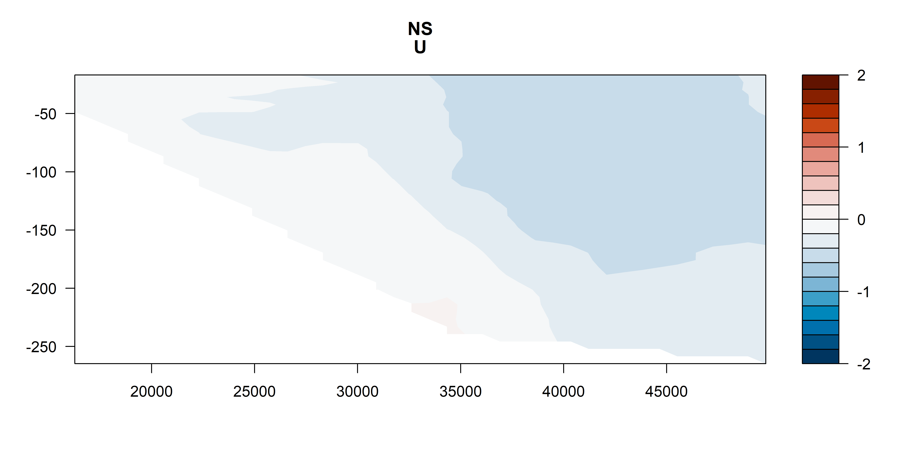
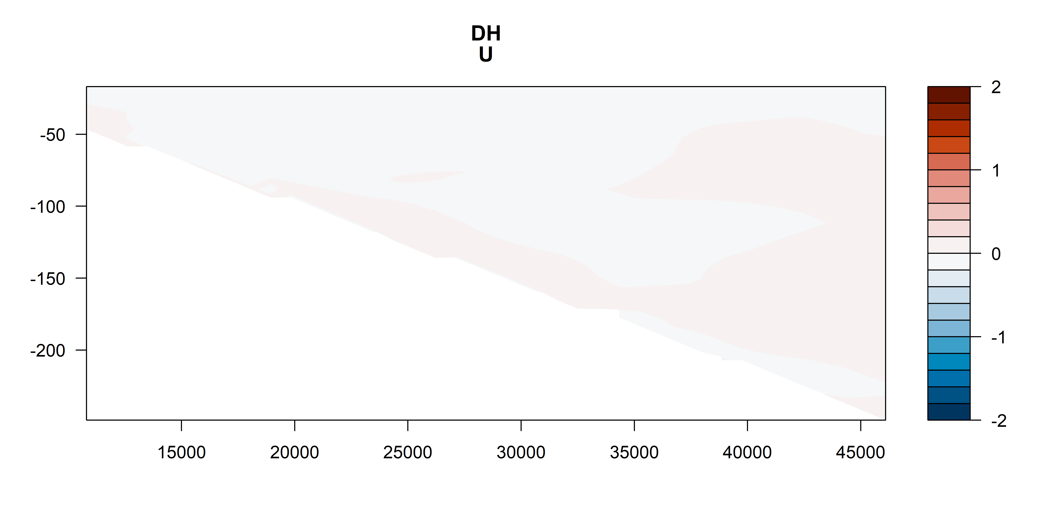
U vectors
m s⁻¹
m s⁻¹
m s⁻¹
m s⁻¹

Slide 12
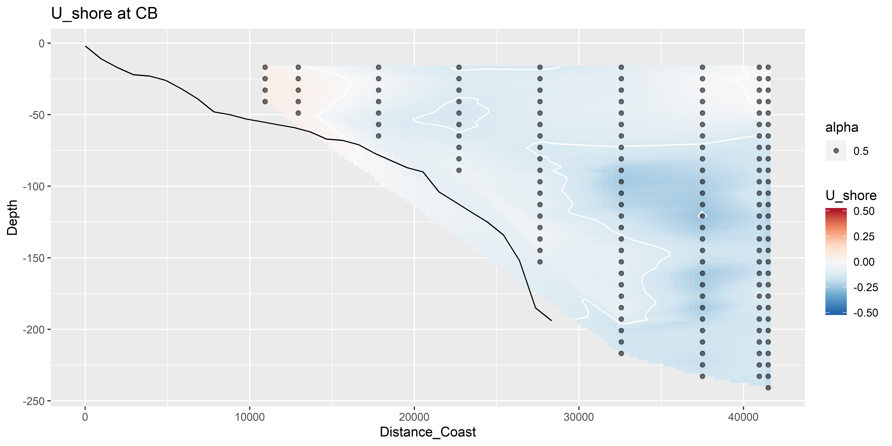
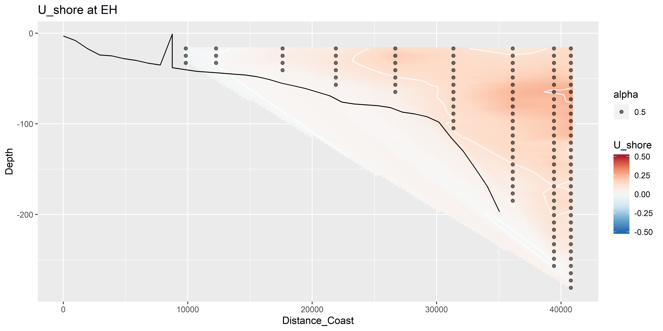
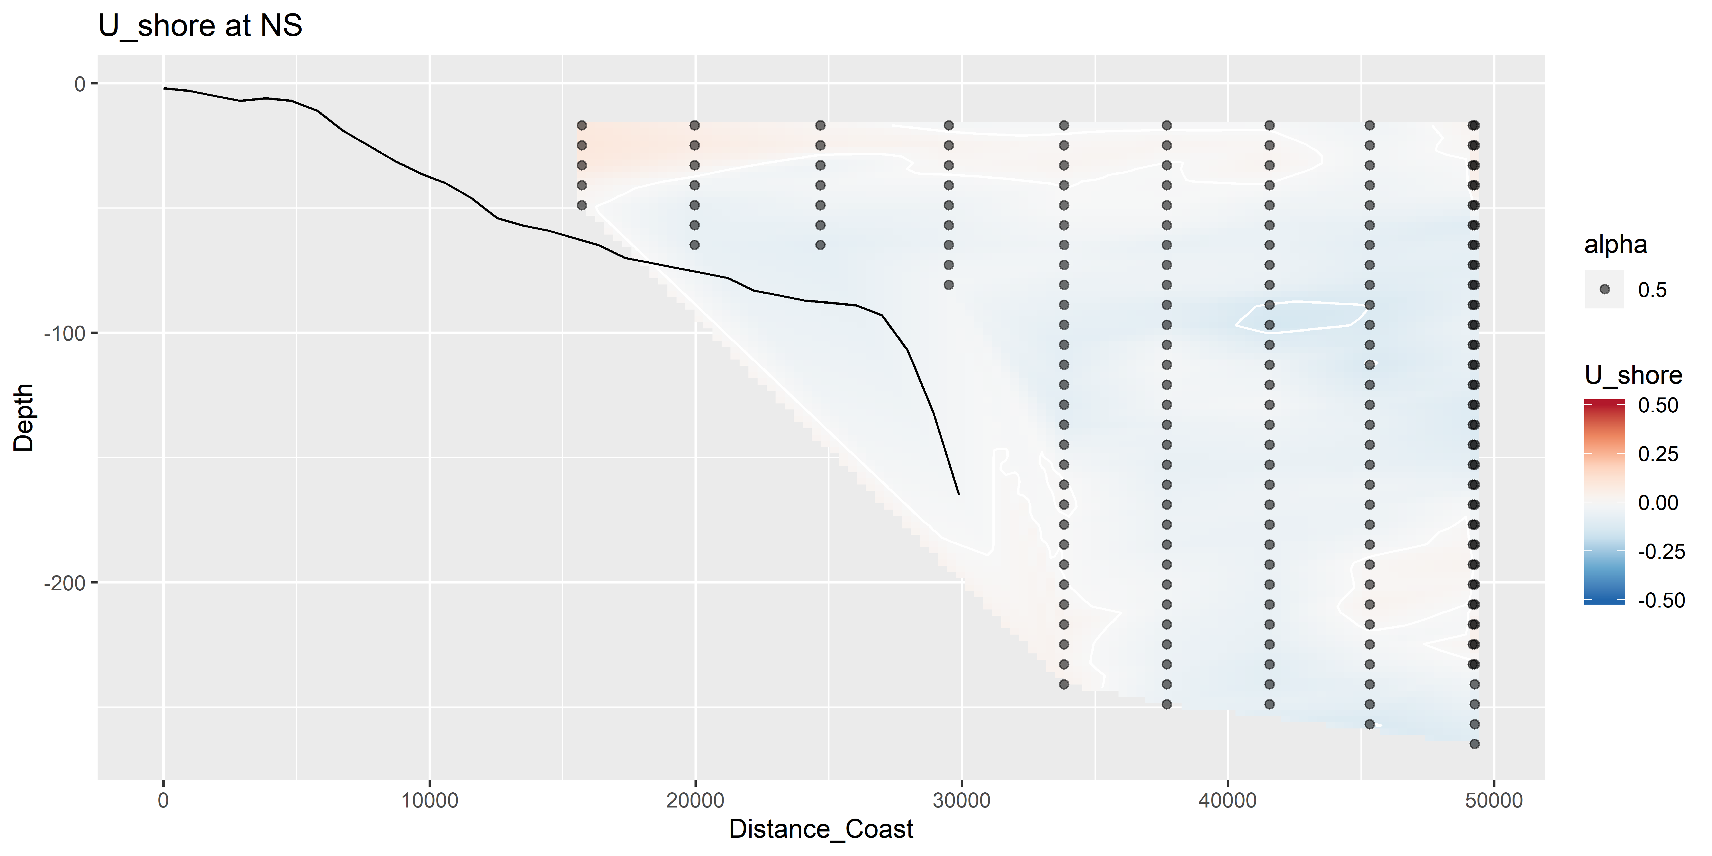
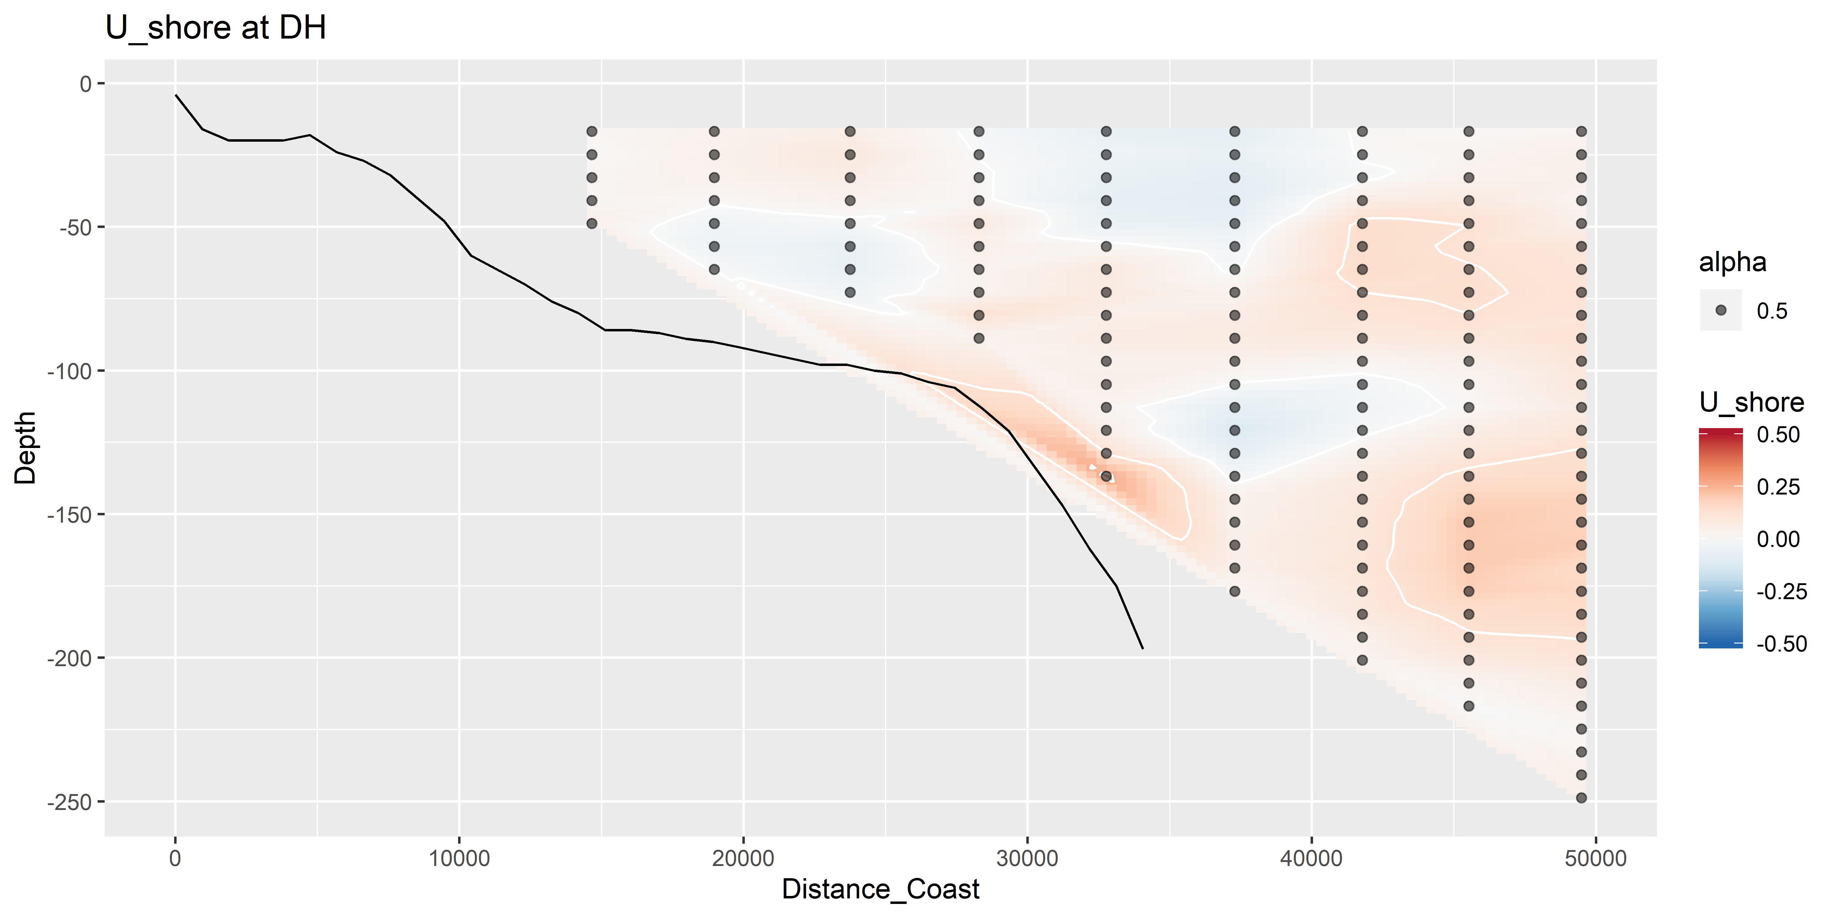
U vectors – shoreline rotated (m s⁻¹)

Slide 13
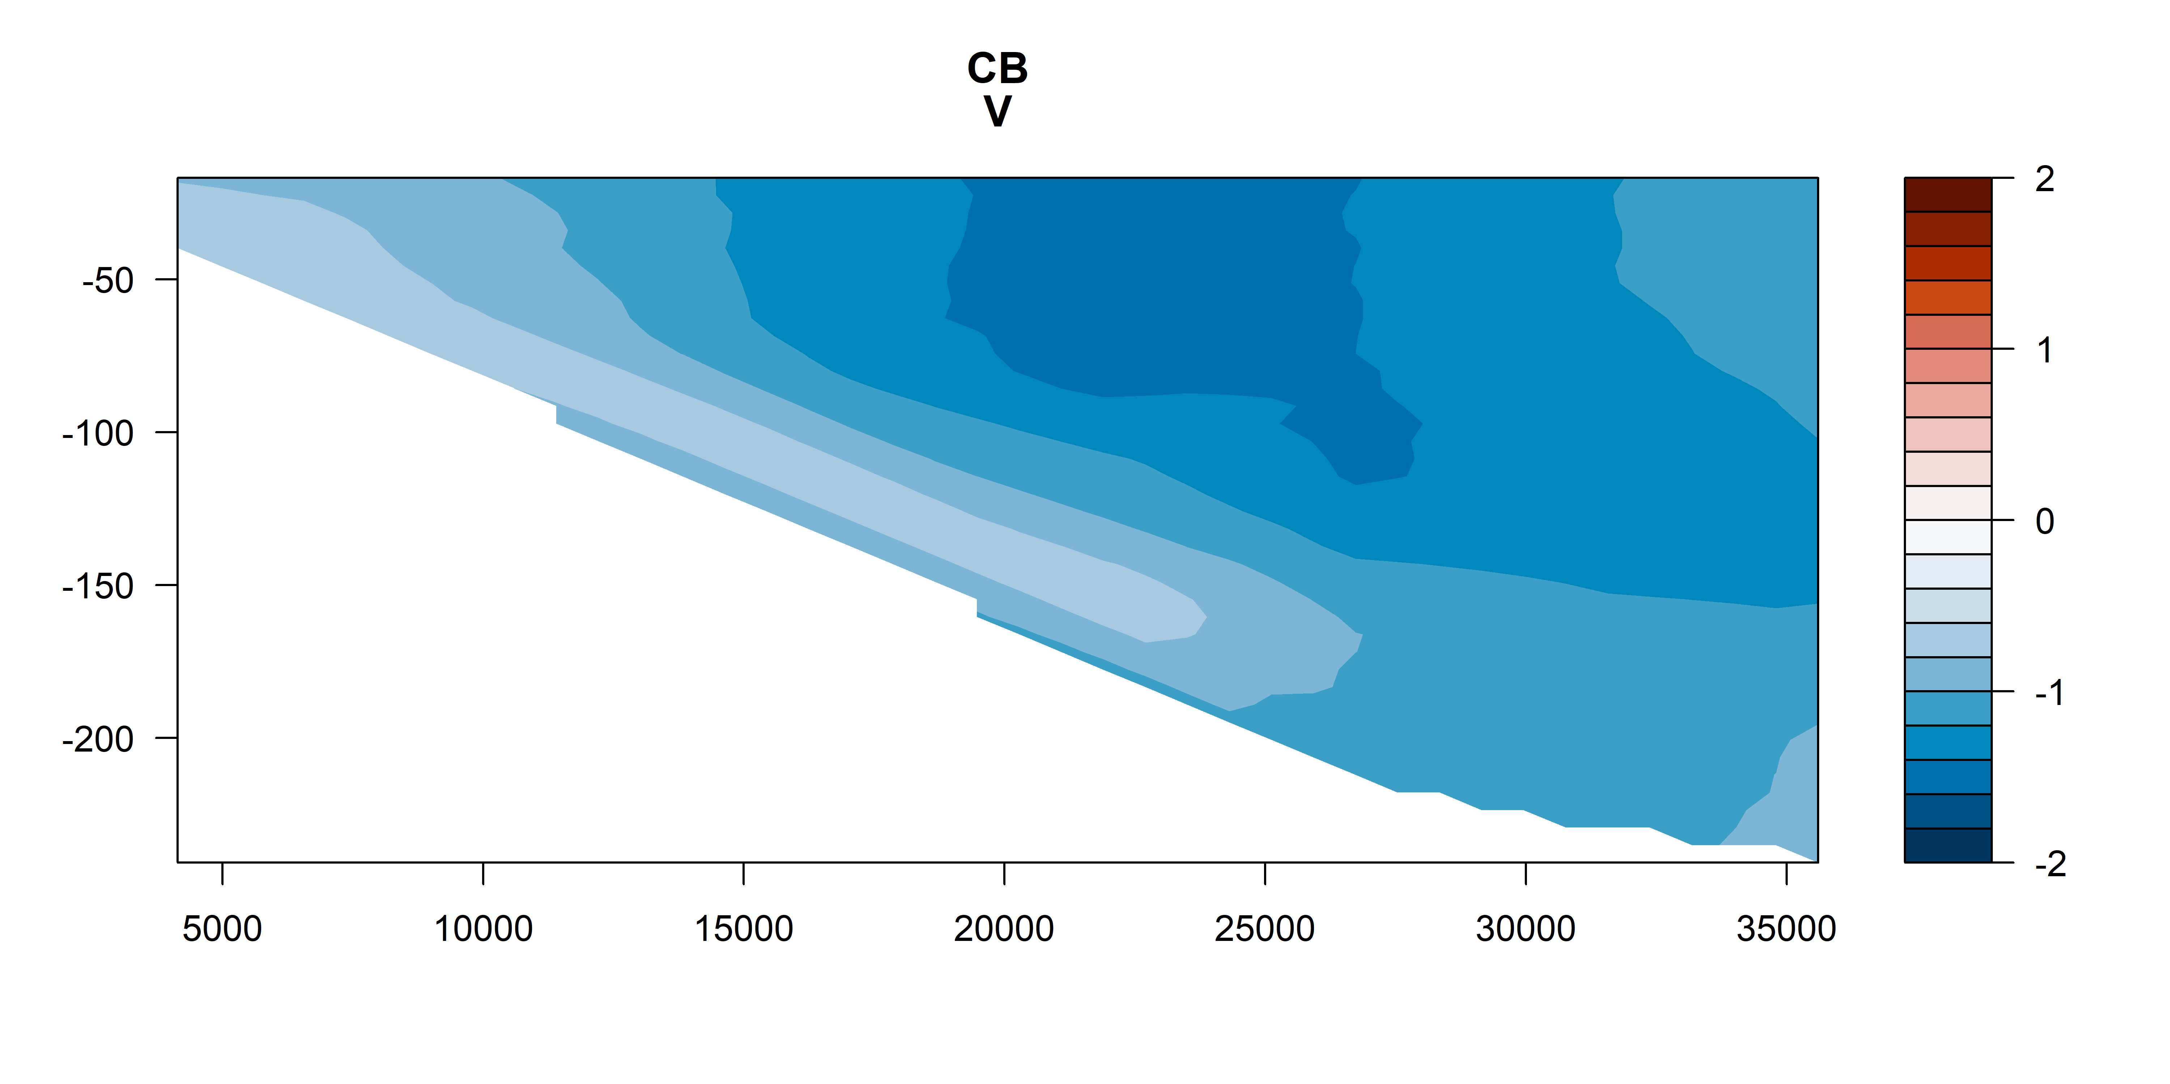
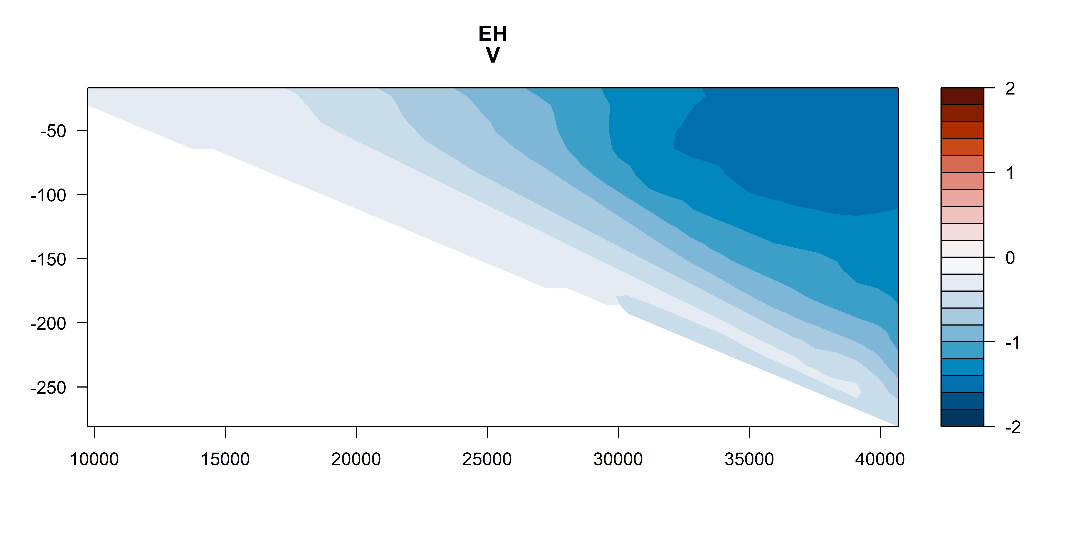
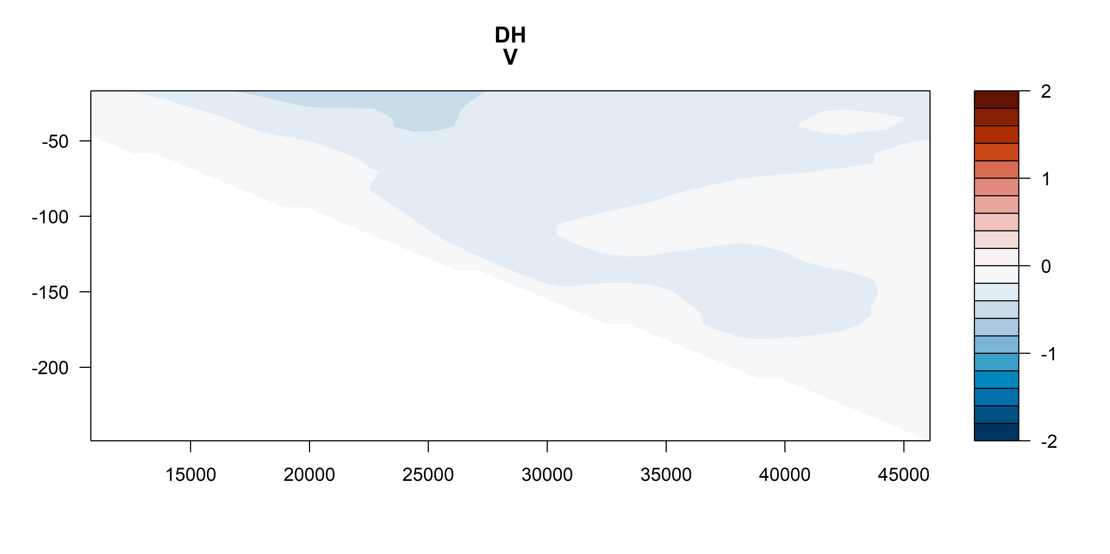
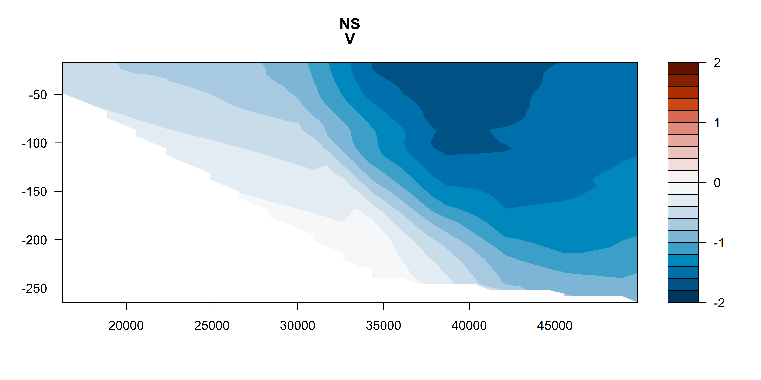
V vectors
m s⁻¹
m s⁻¹
m s⁻¹
m s⁻¹

Slide 14
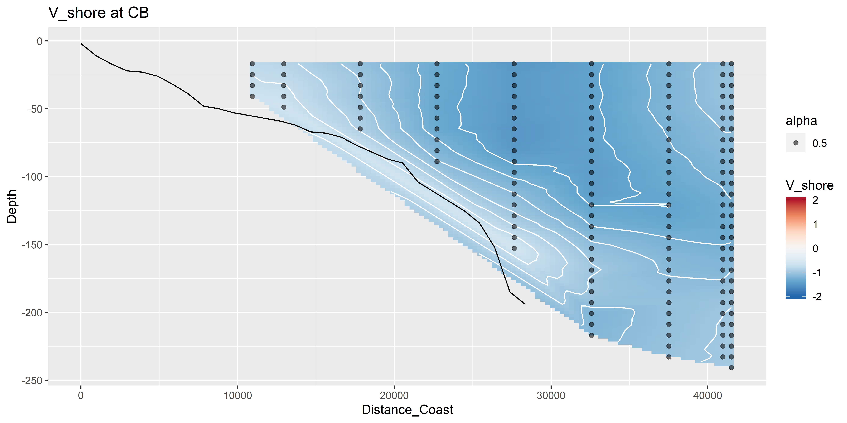
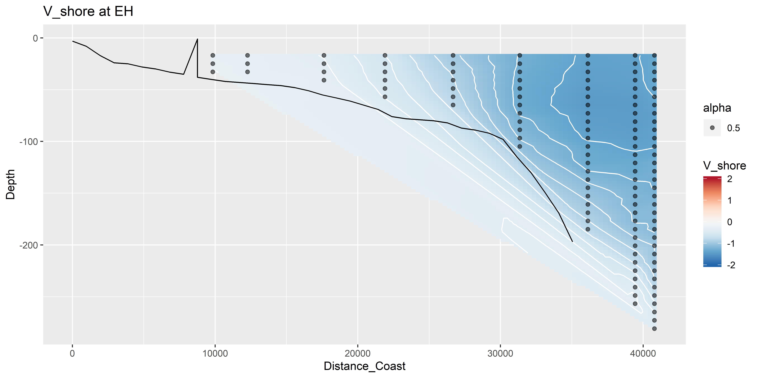
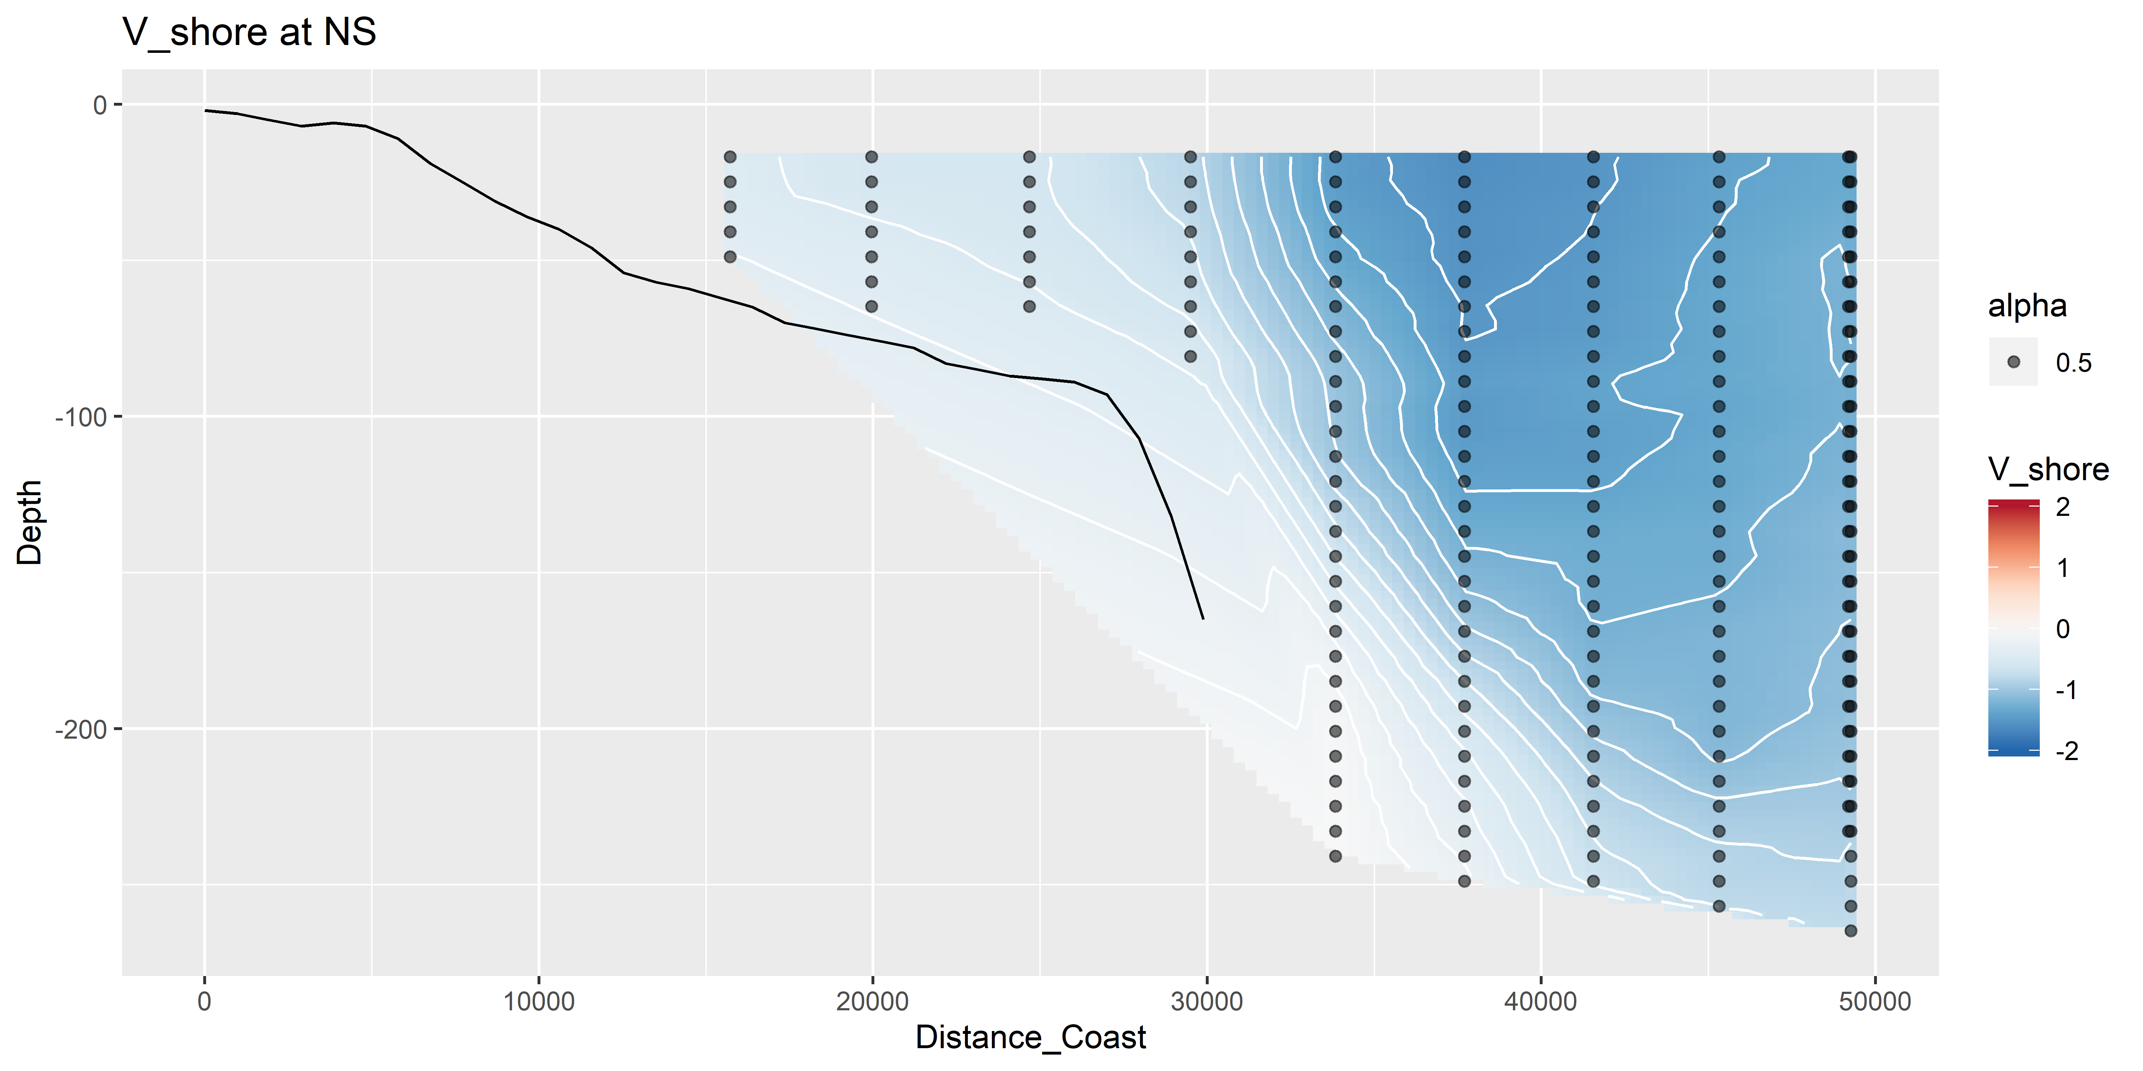
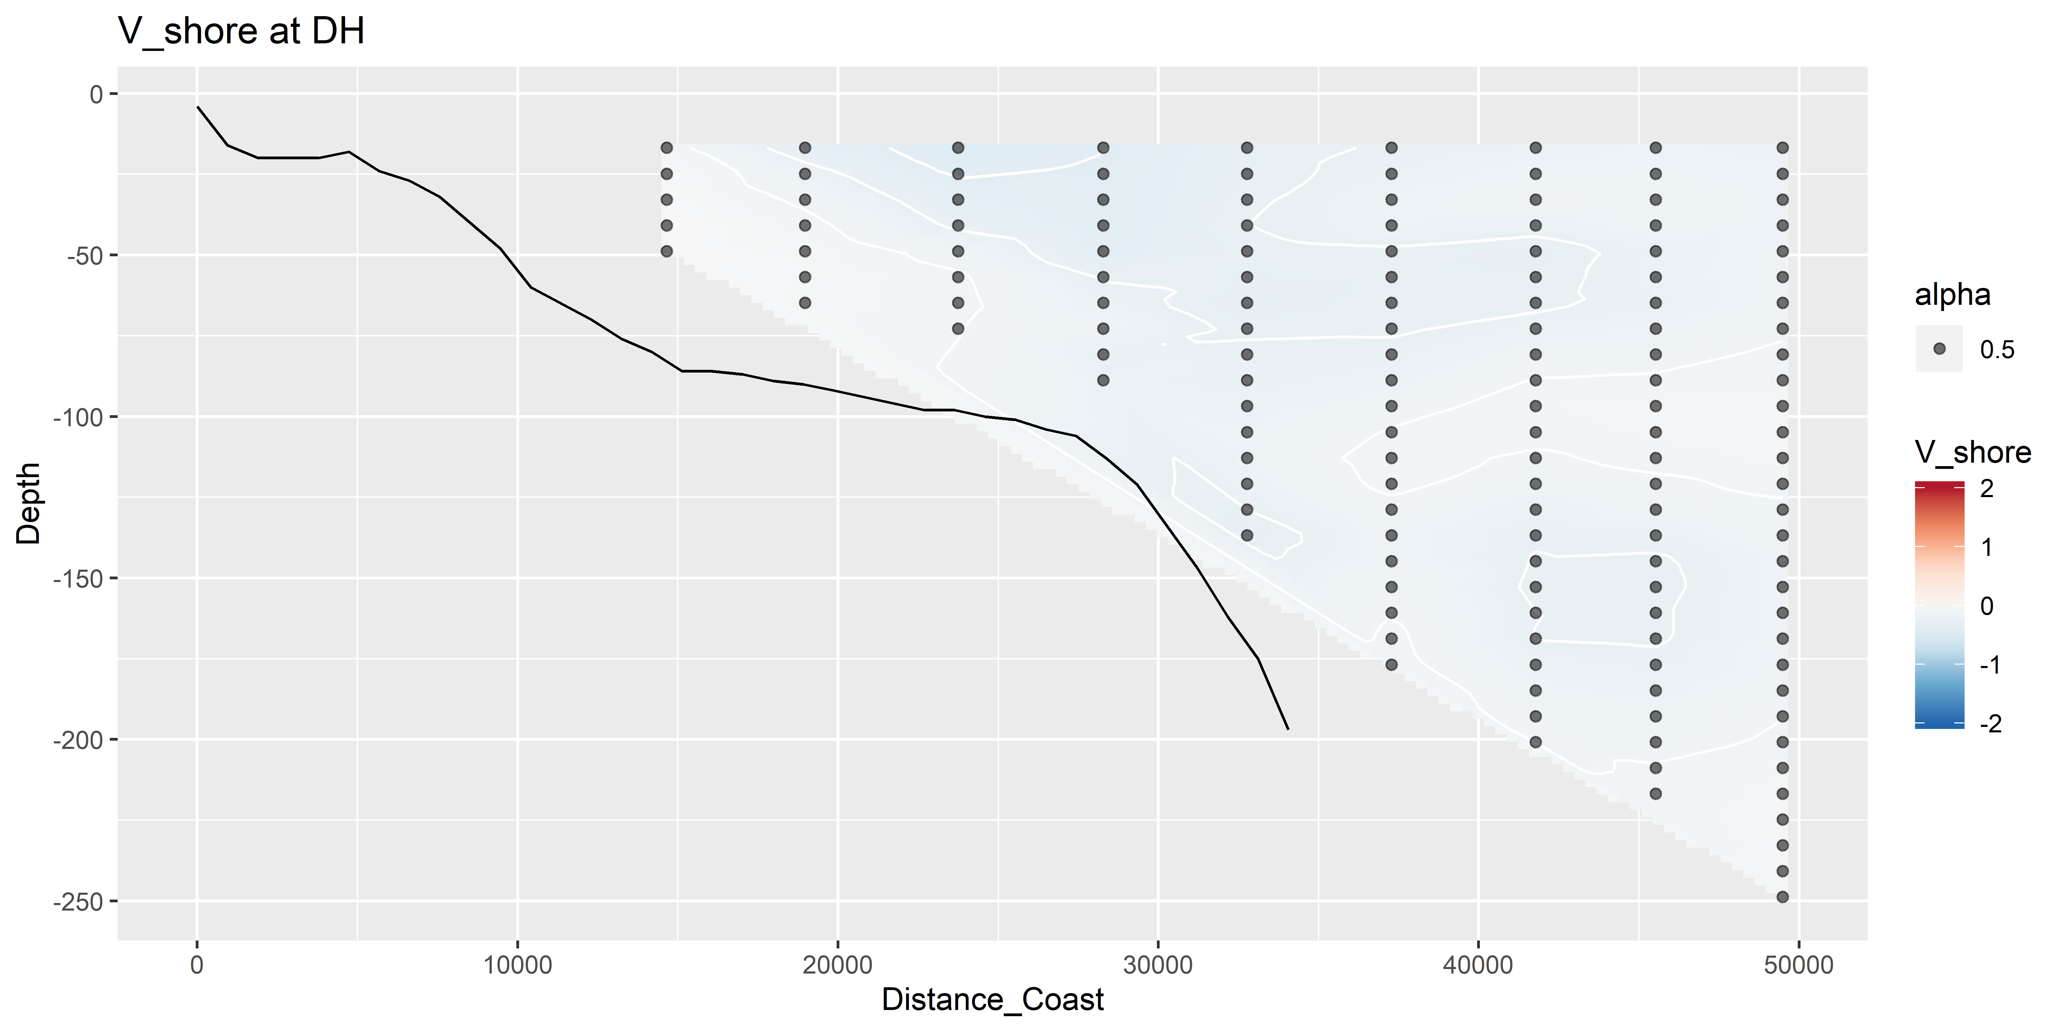
V vectors – shoreline rotated (m s⁻¹)

Slide 15
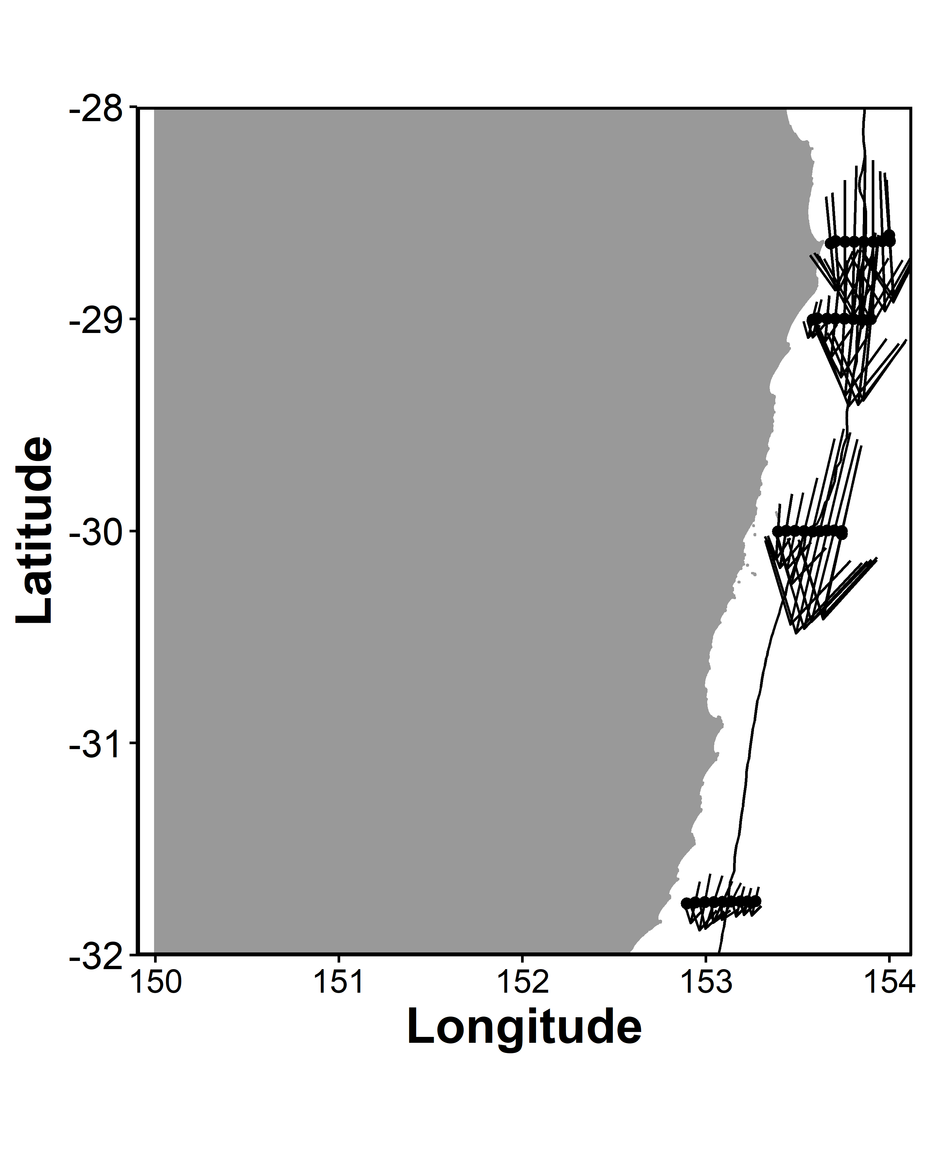
ADCP Velocity on a map

Slide 16
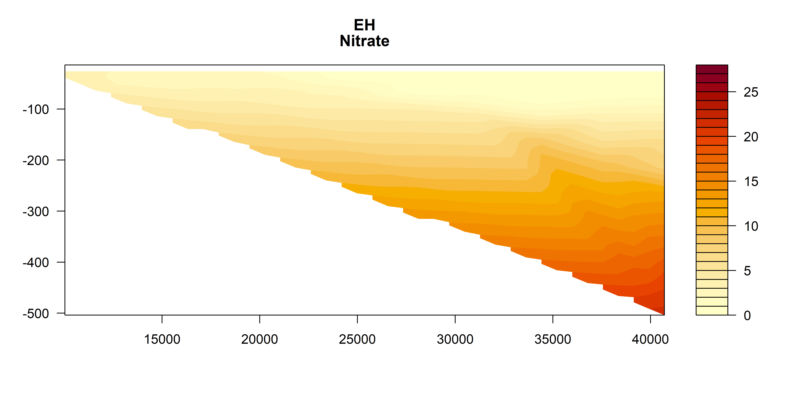
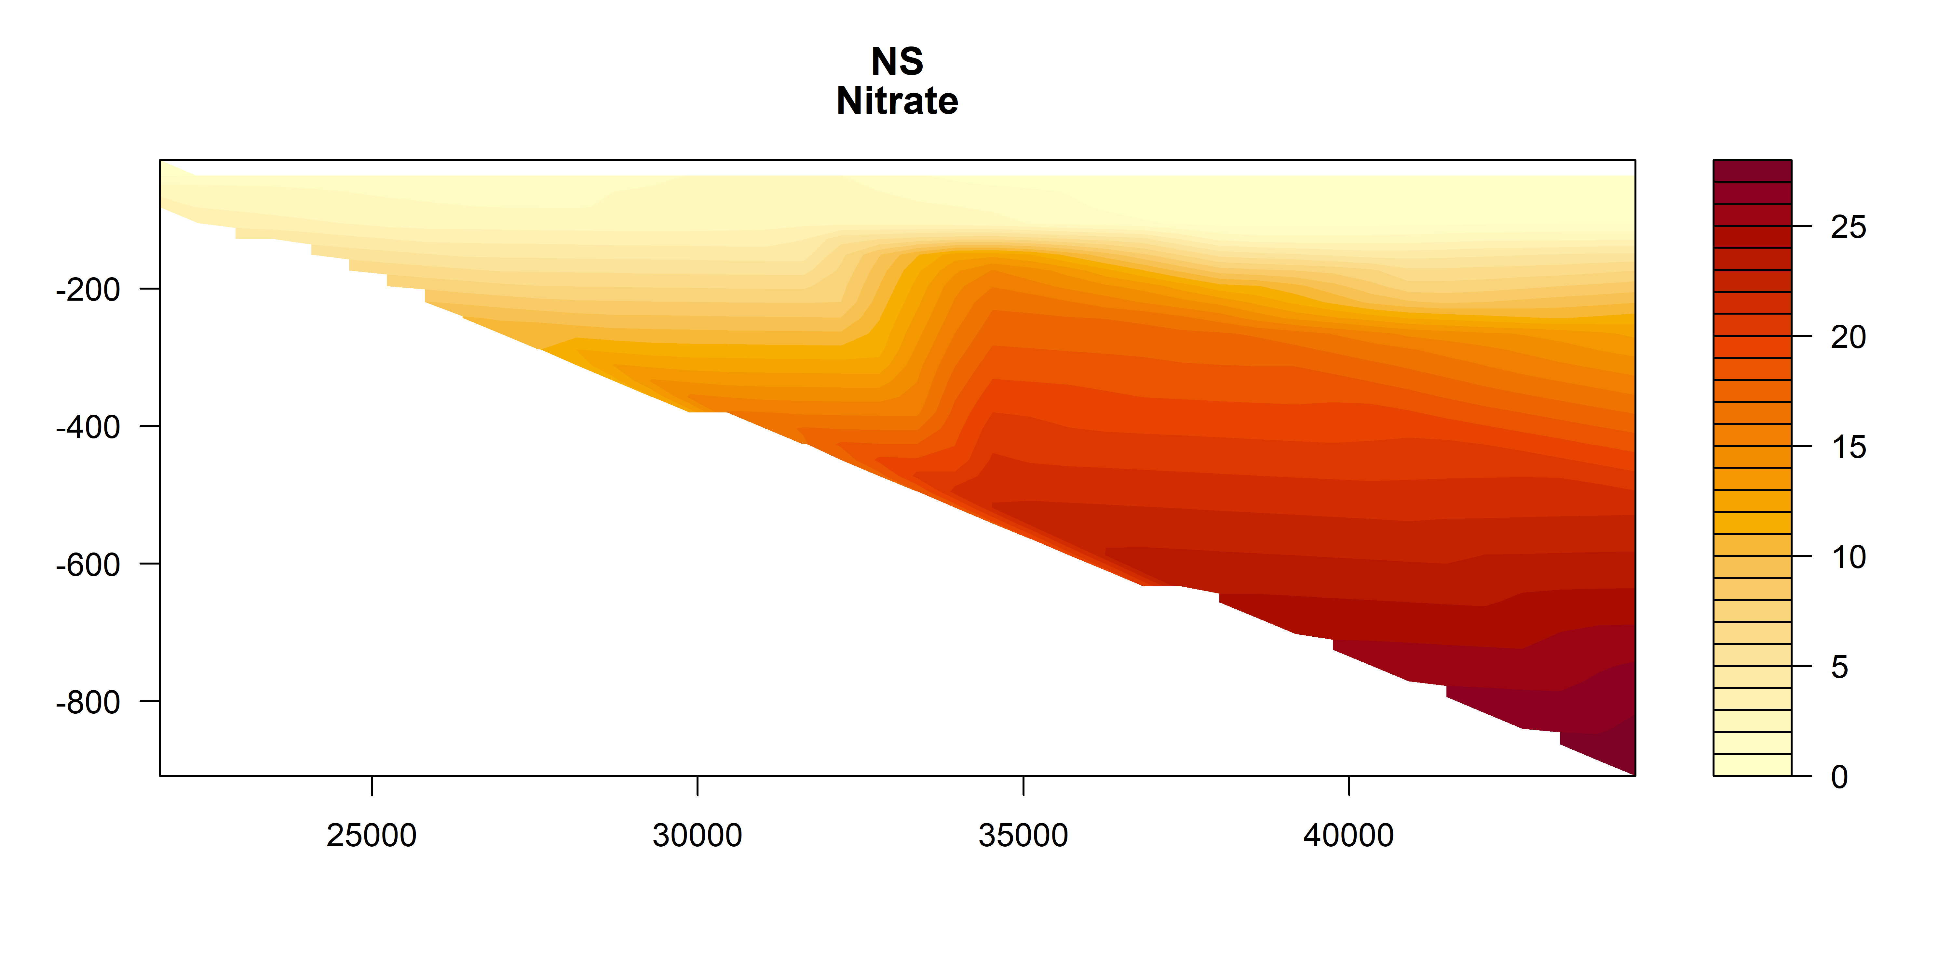
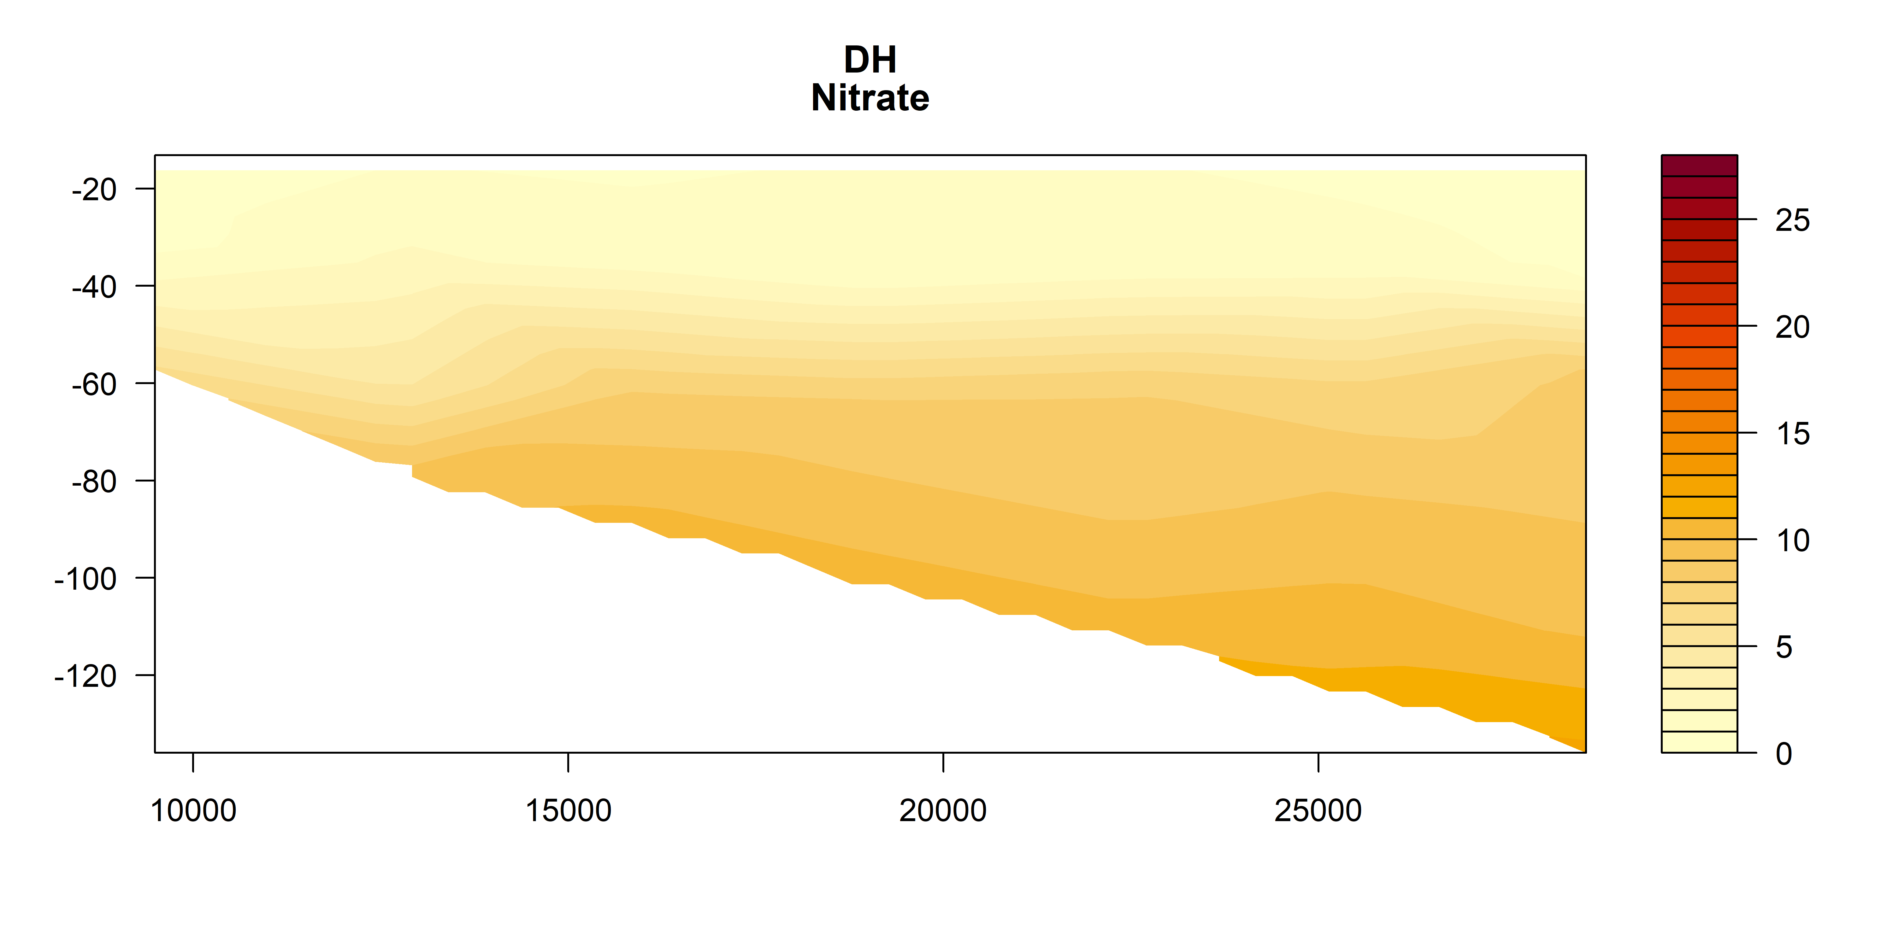
Nitrate

Slide 17
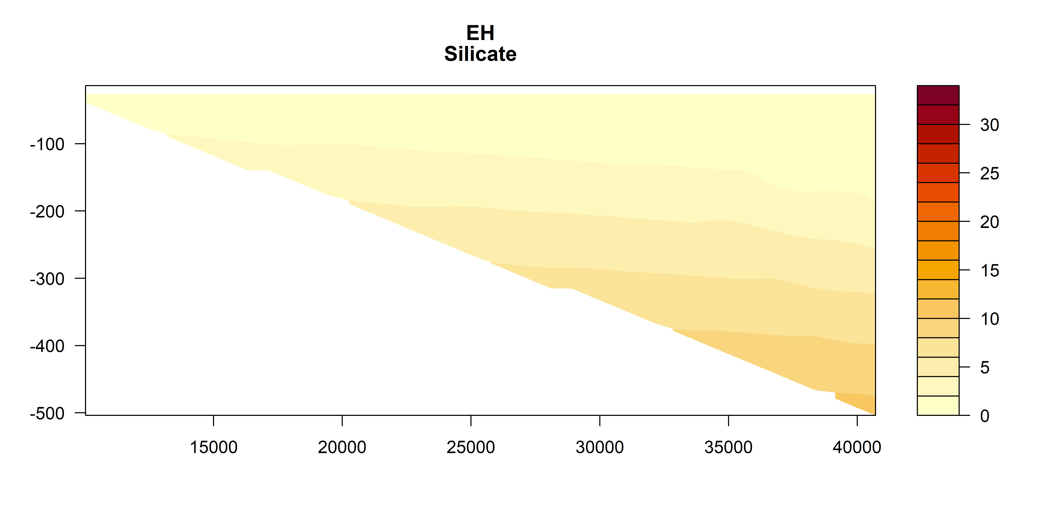
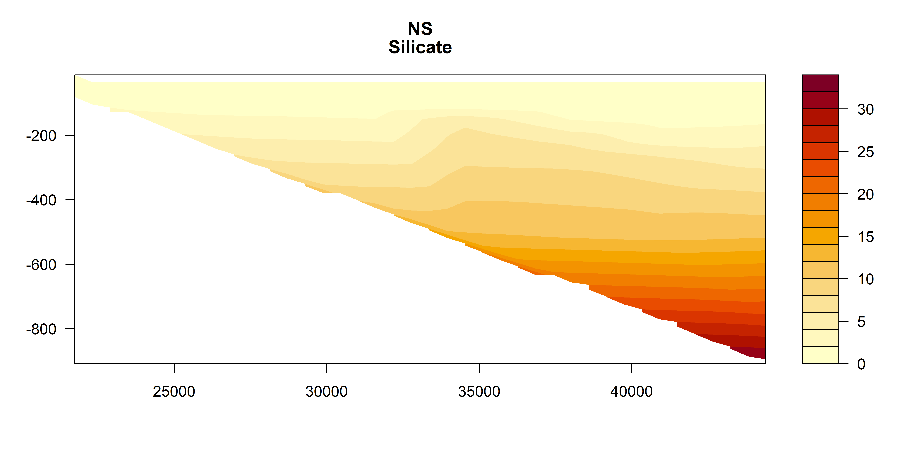
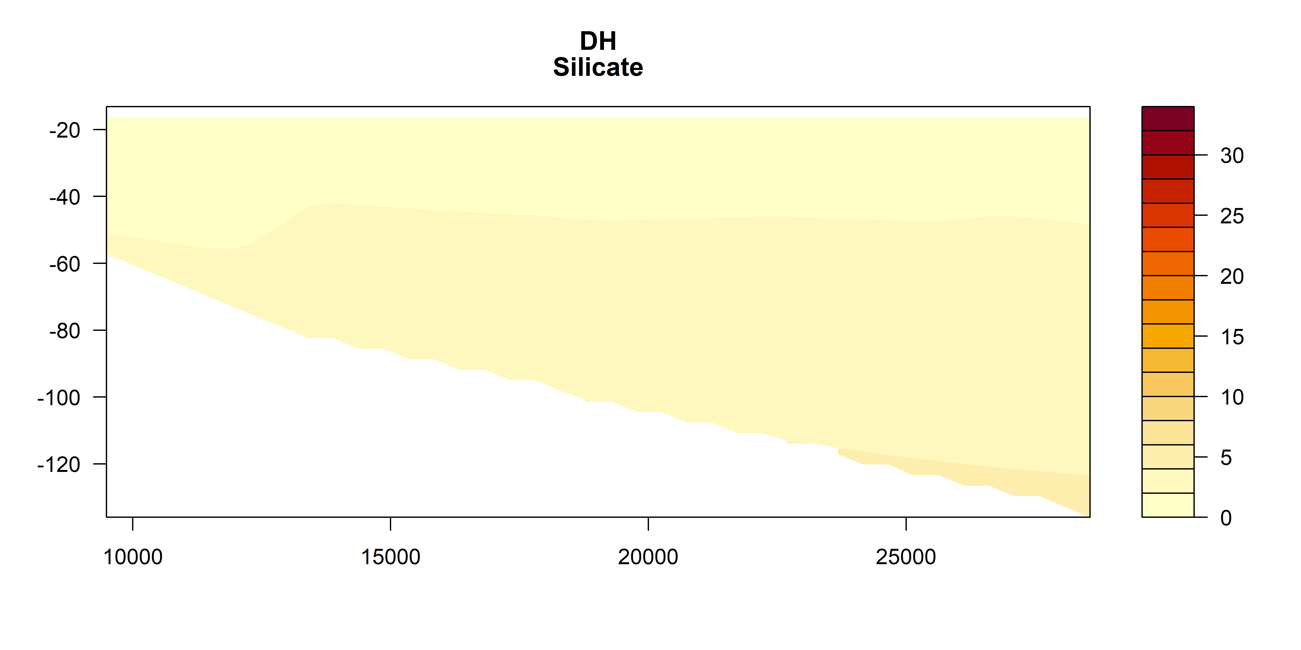
Silicate

Slide 18
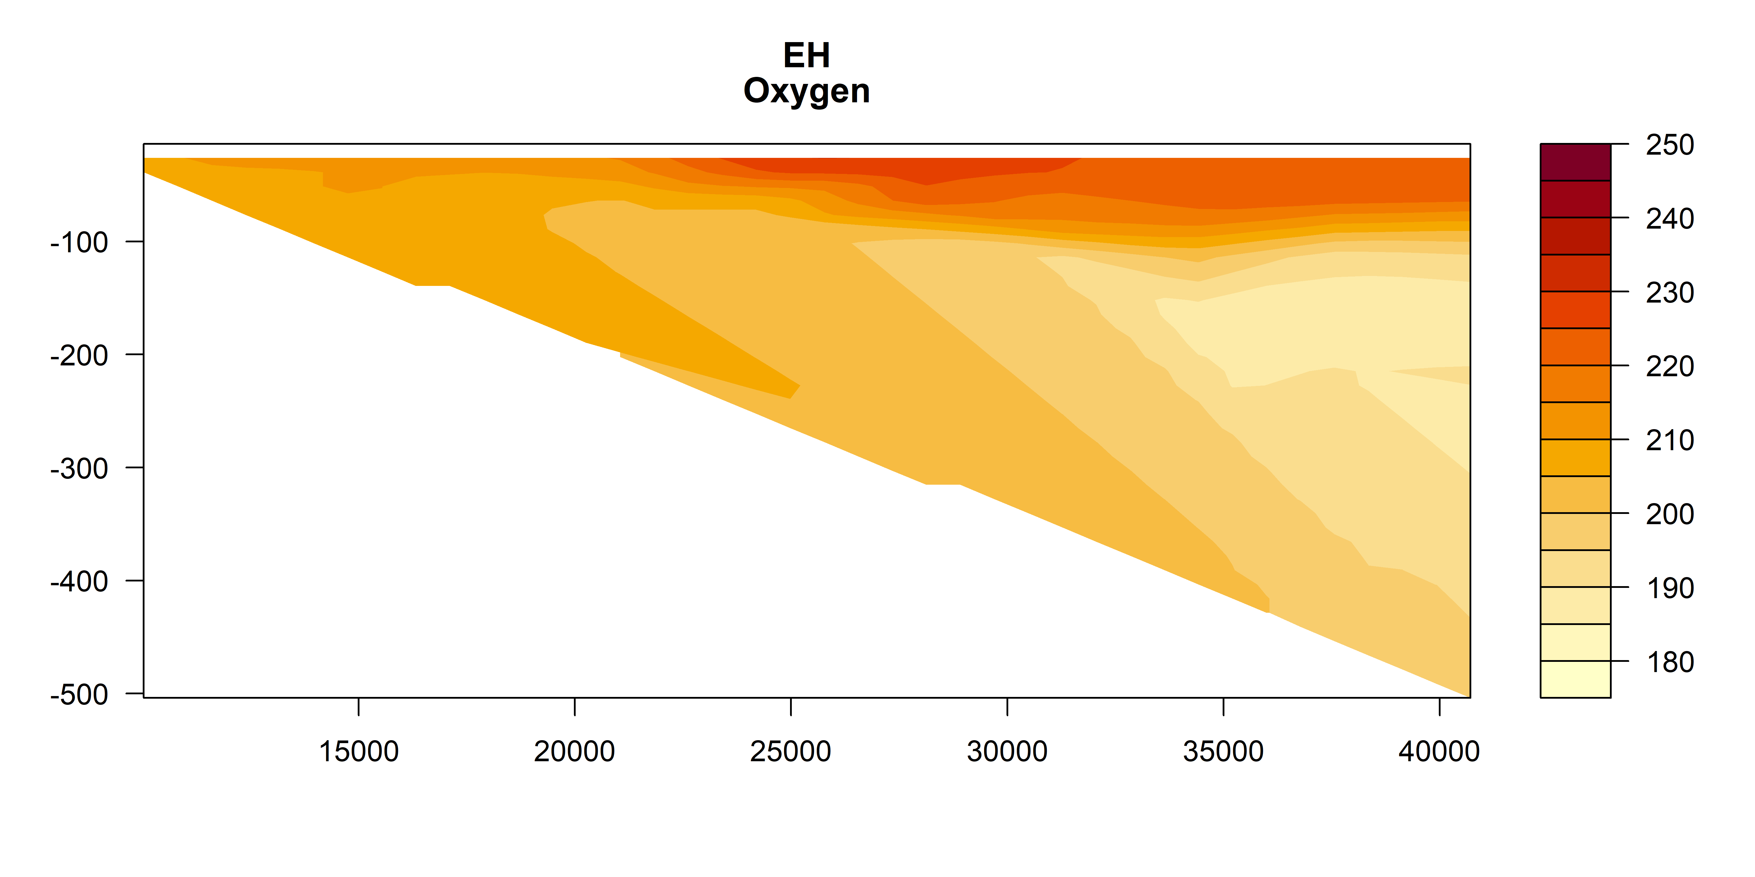
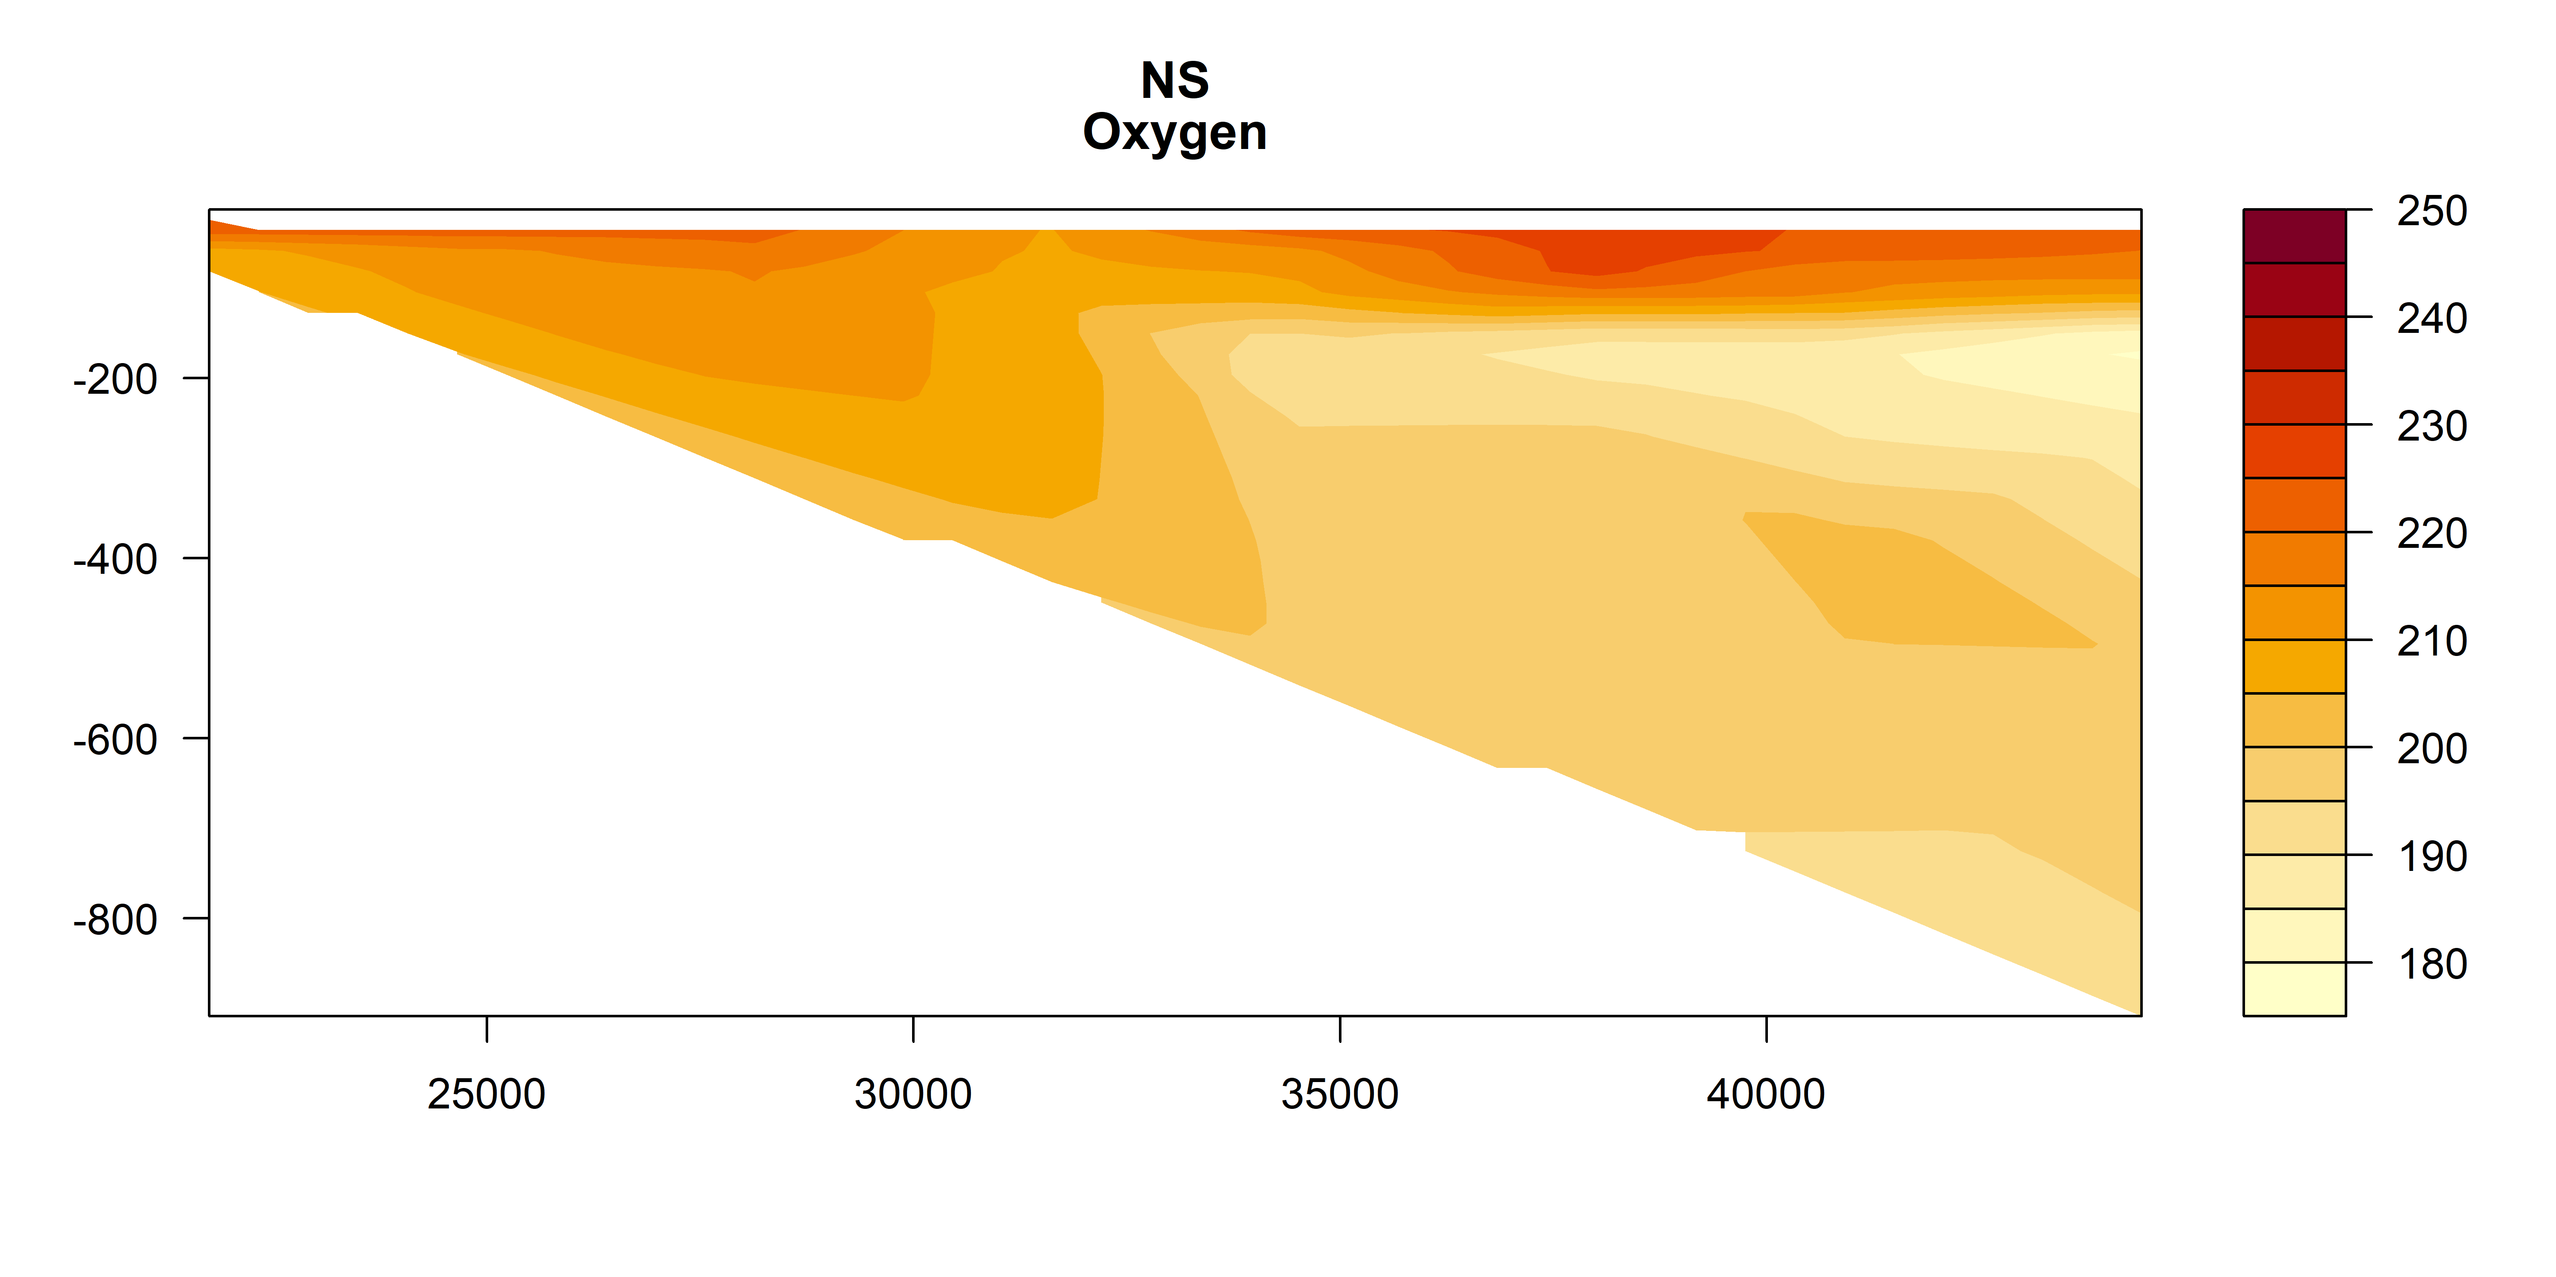
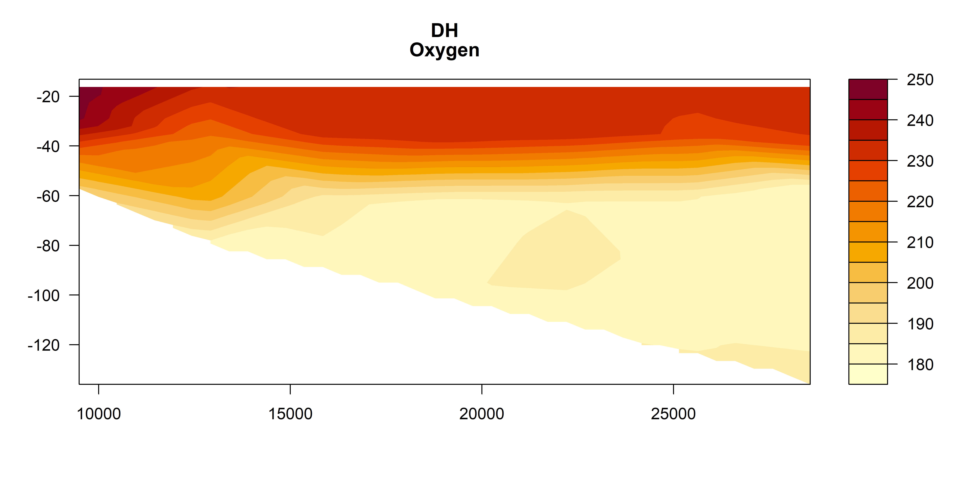
Oxygen

Slide 19
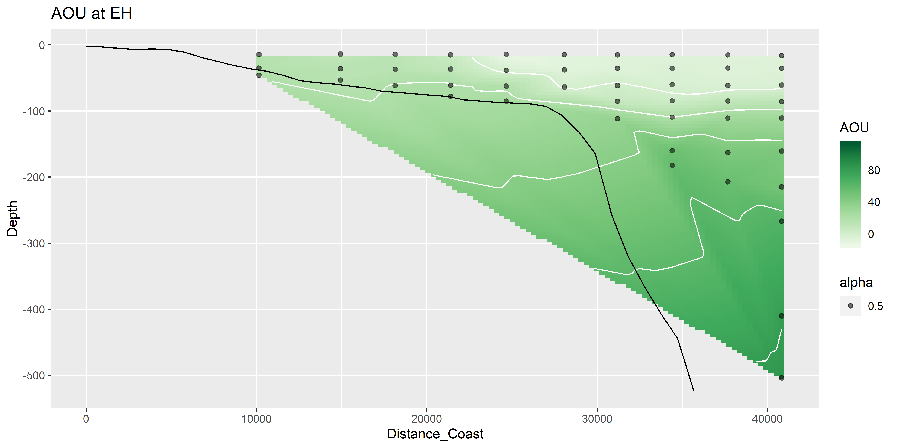
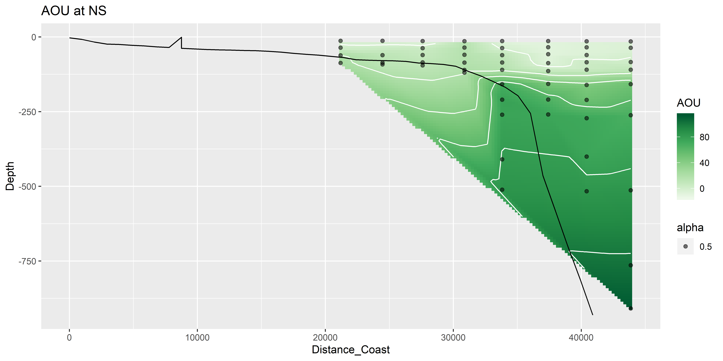
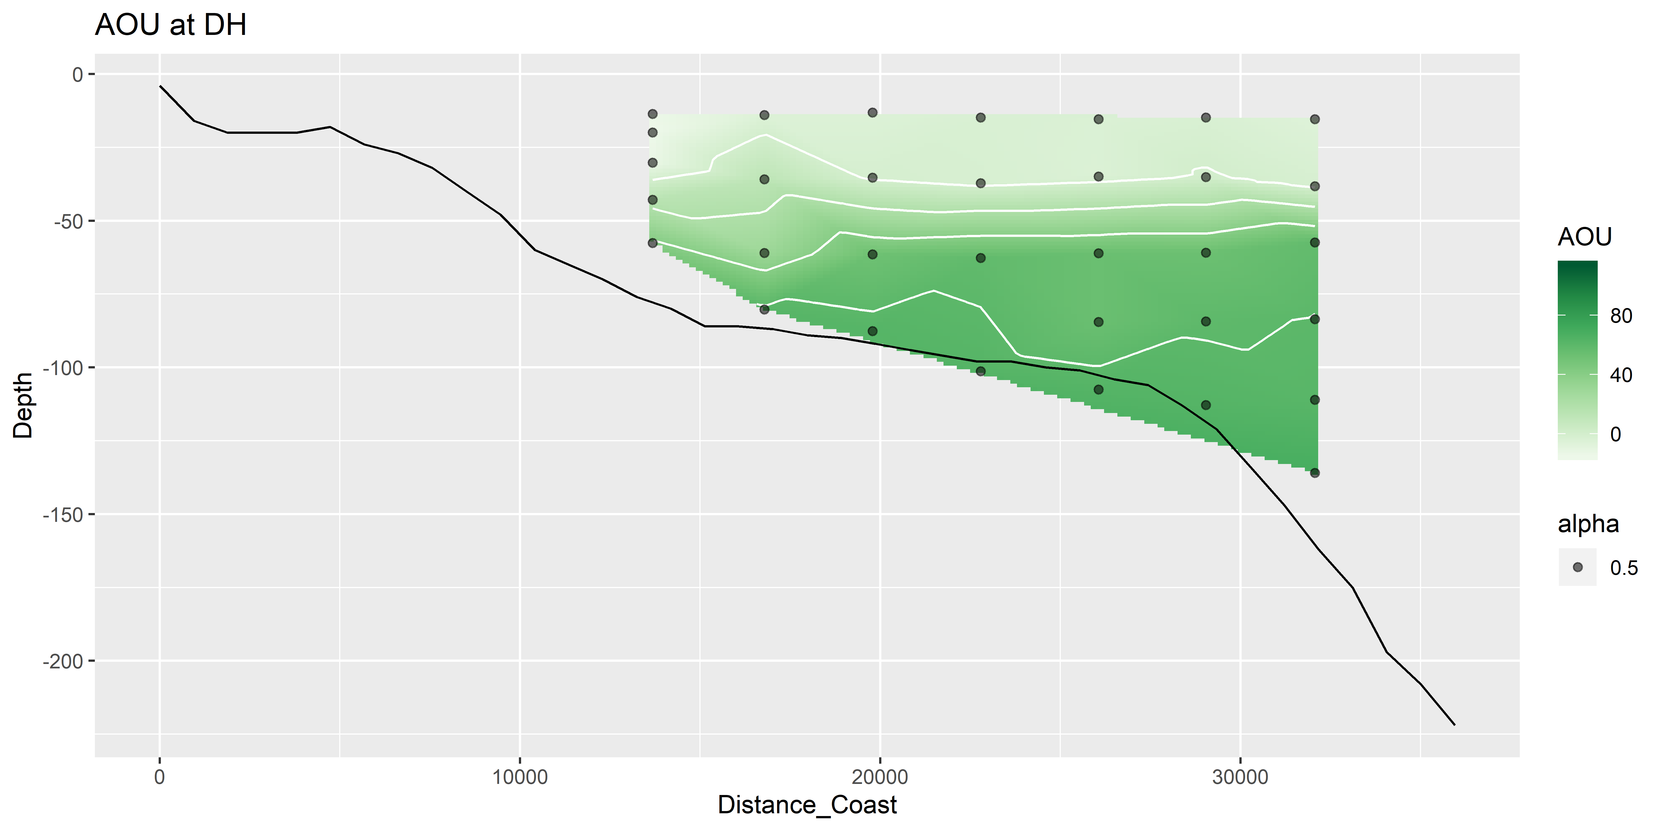
Oxygen utilisation (expected – observed)
um/kg
Positive = respiration (lower O₂ than expected)
Negative = photosynthesis / production
um/kg
um/kg

Slide 20
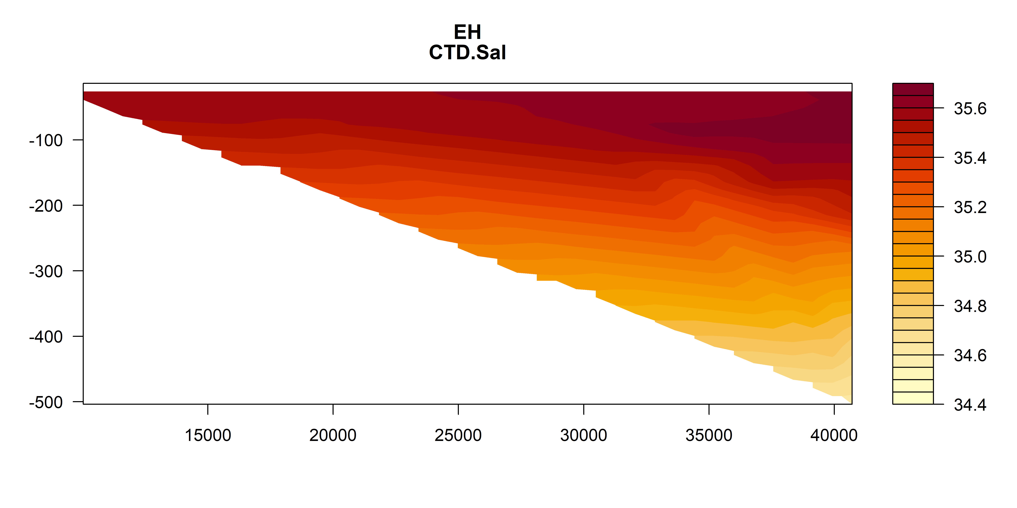
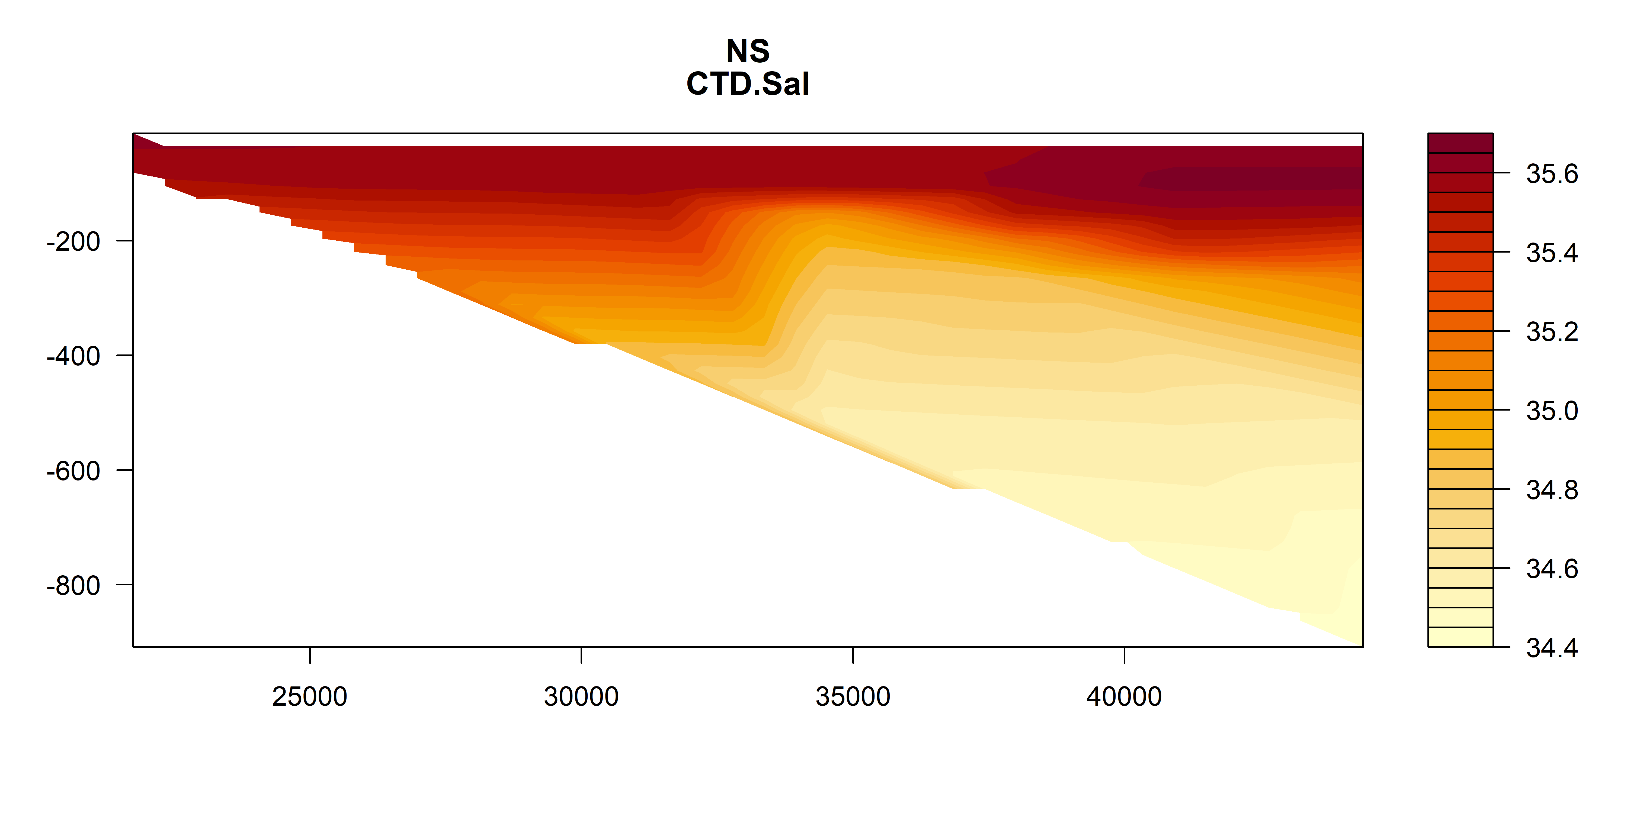
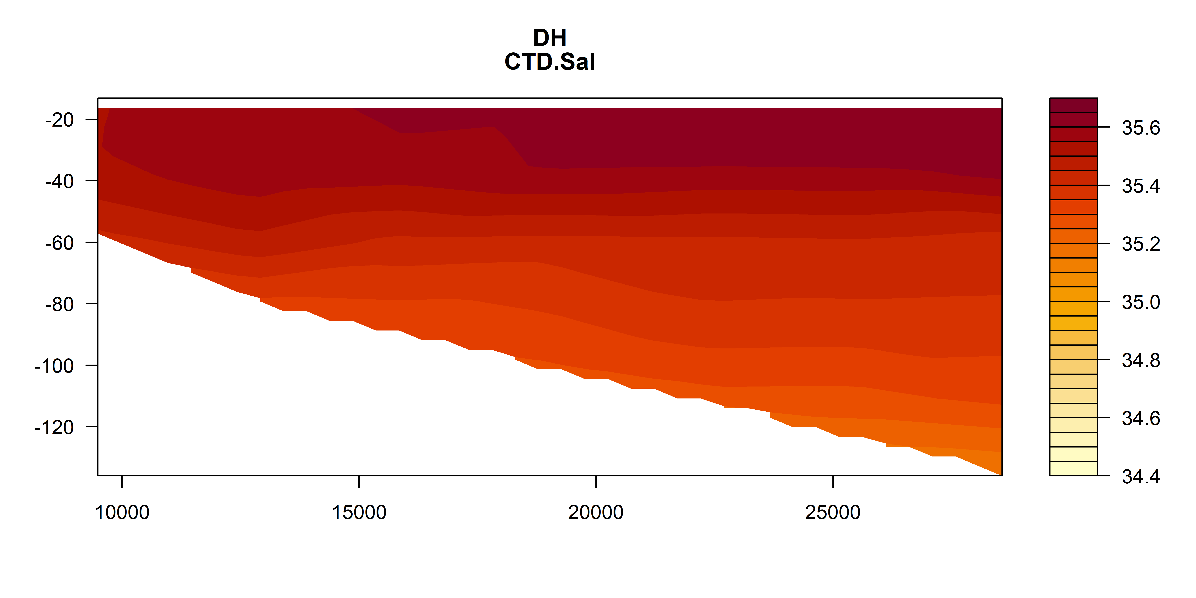
Salinity

Slide 21
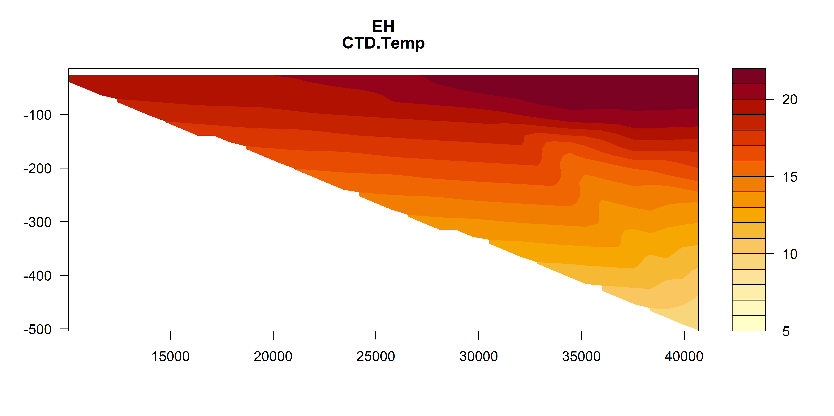
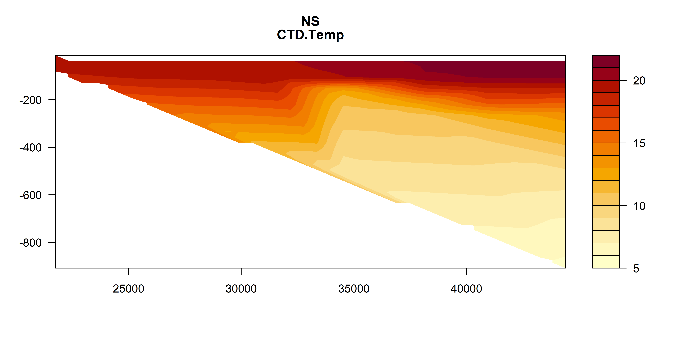
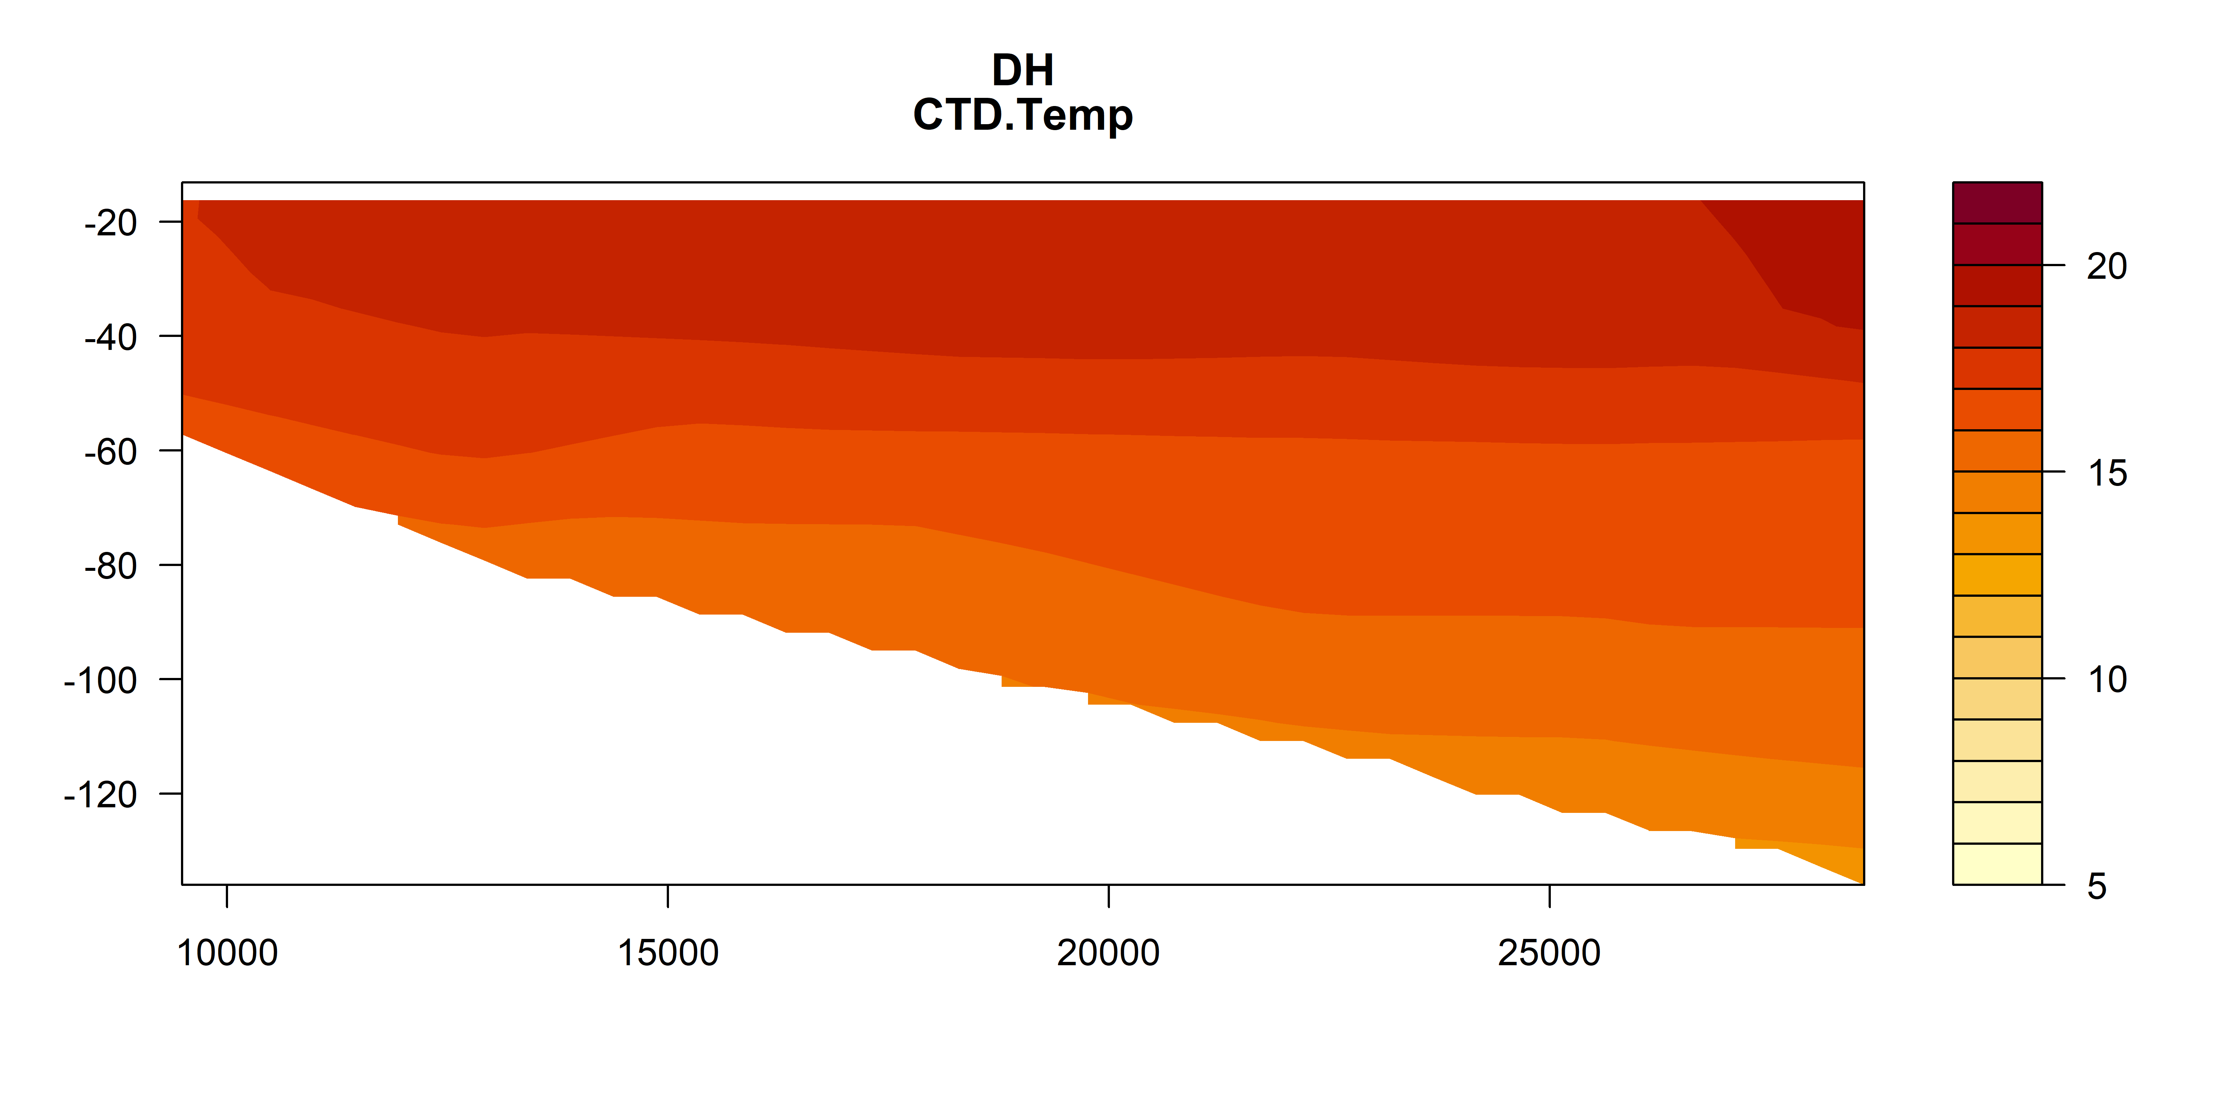
Temperature
Deg C
Deg C
Deg C

Slide 22
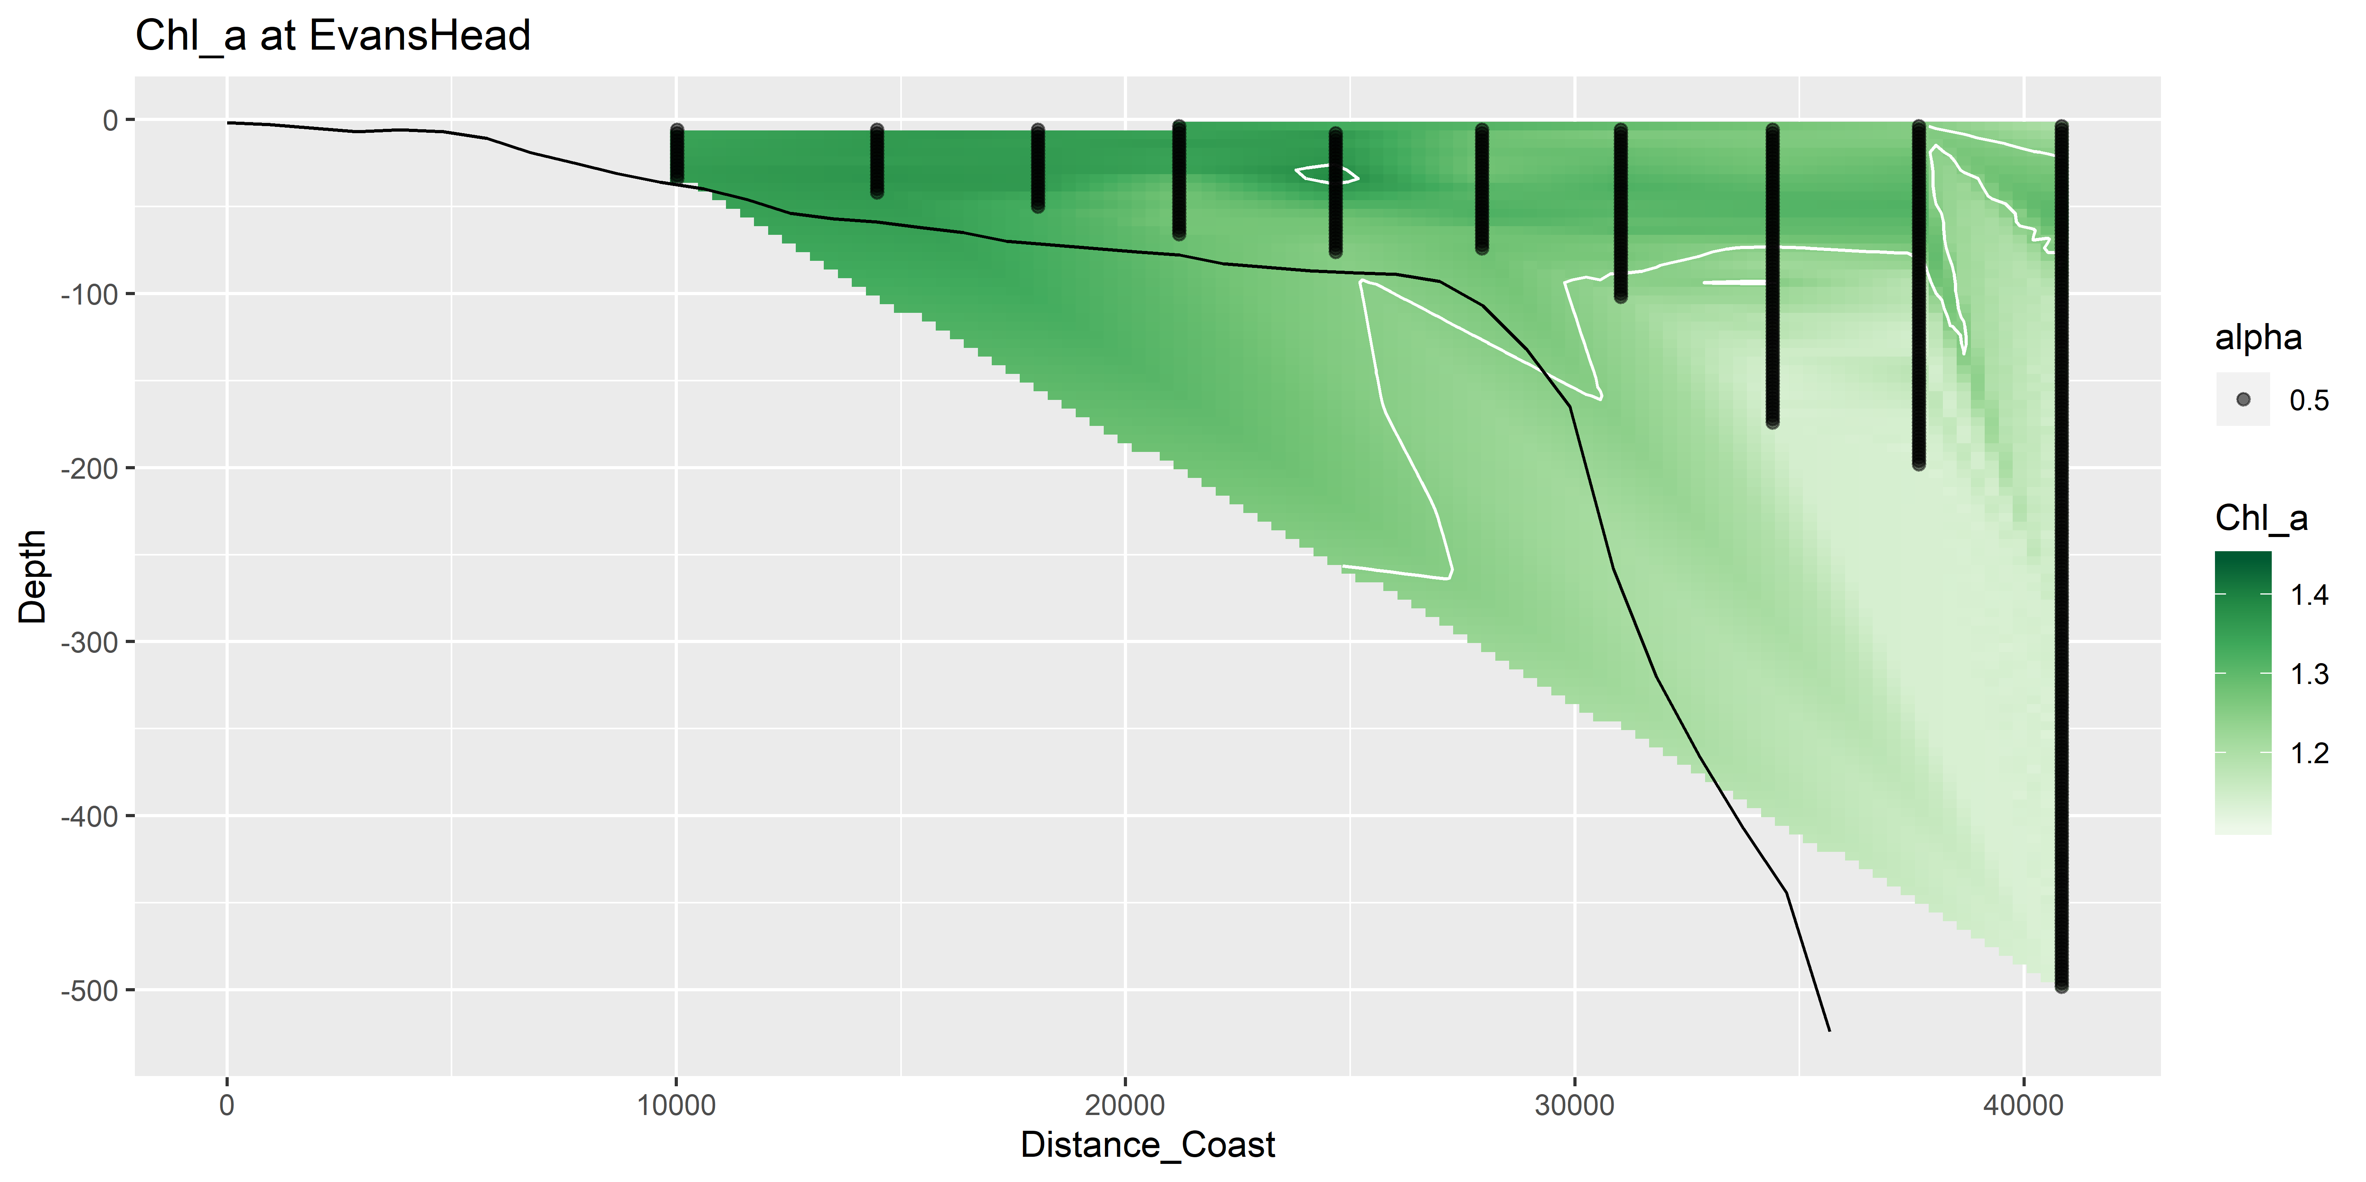
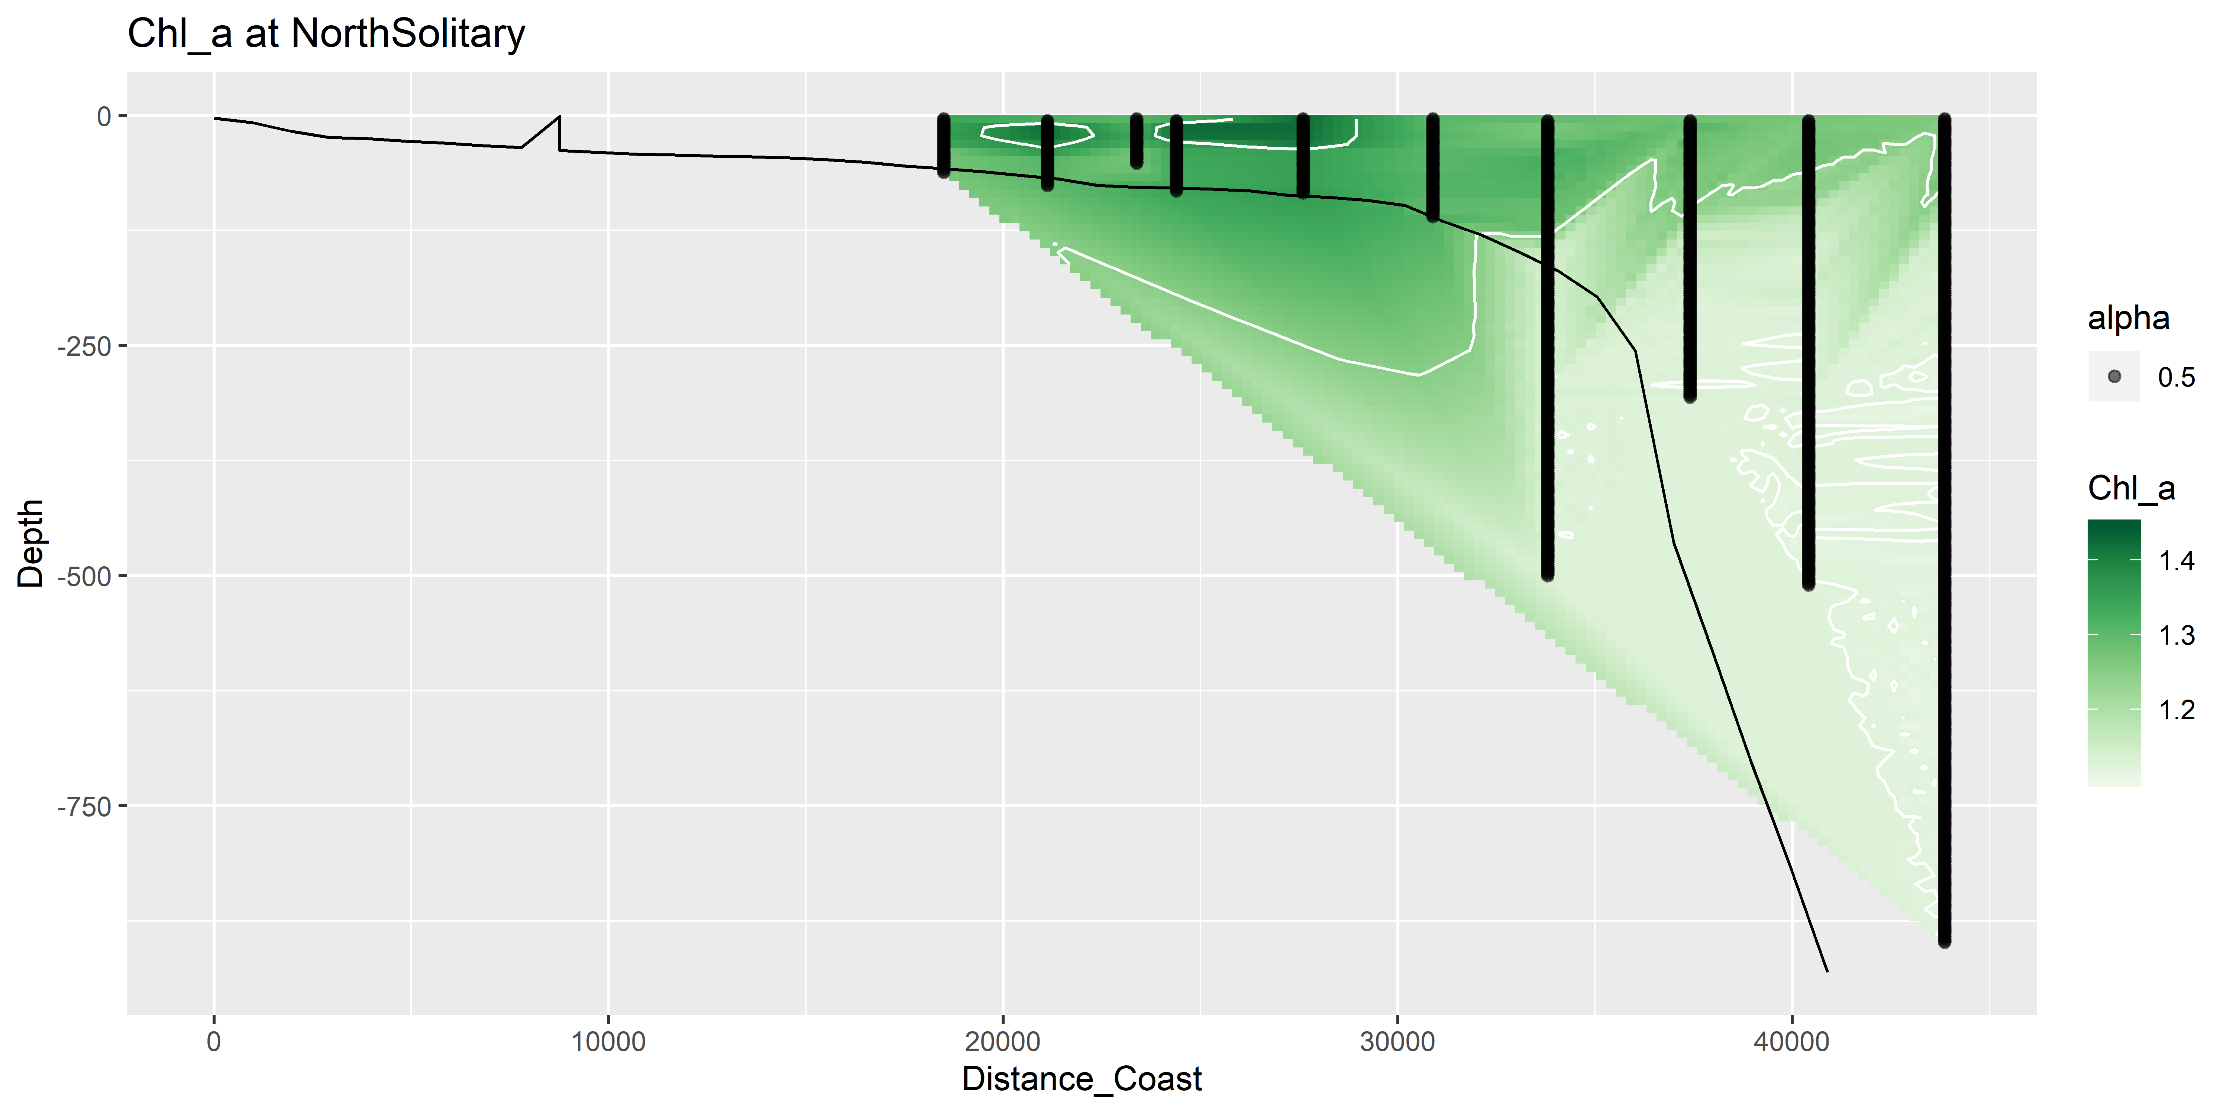
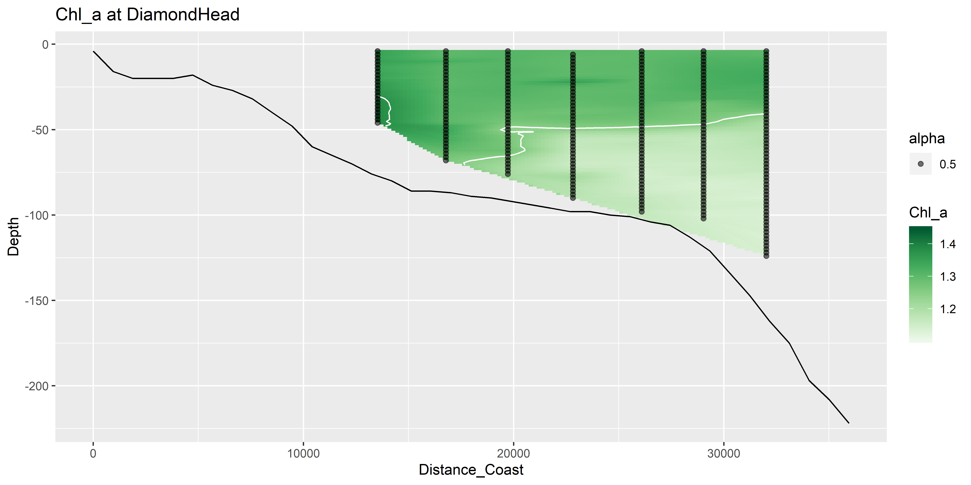
Chl_a

Slide 23
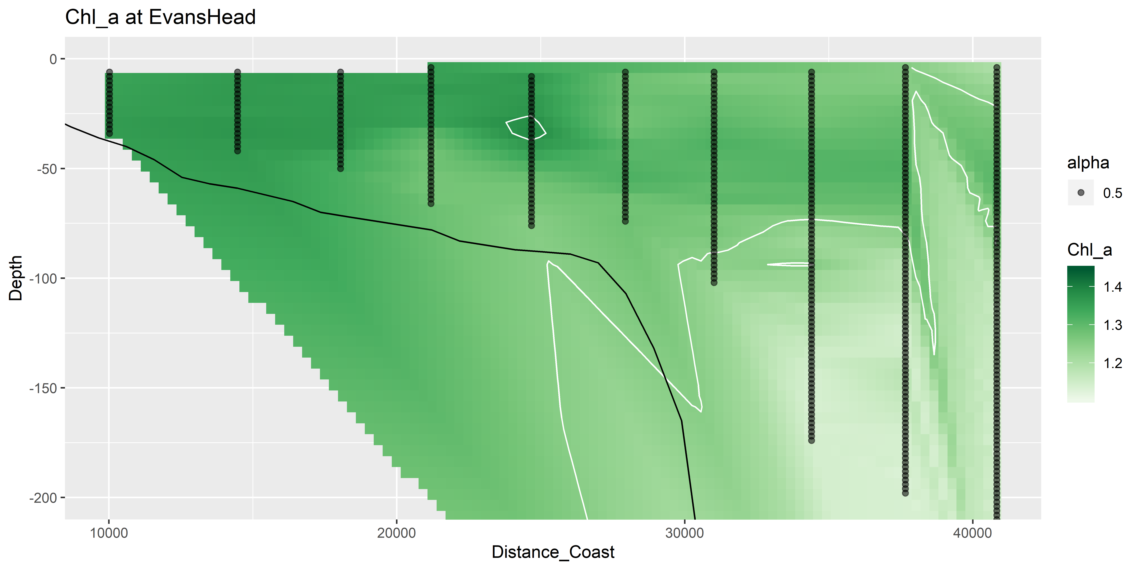
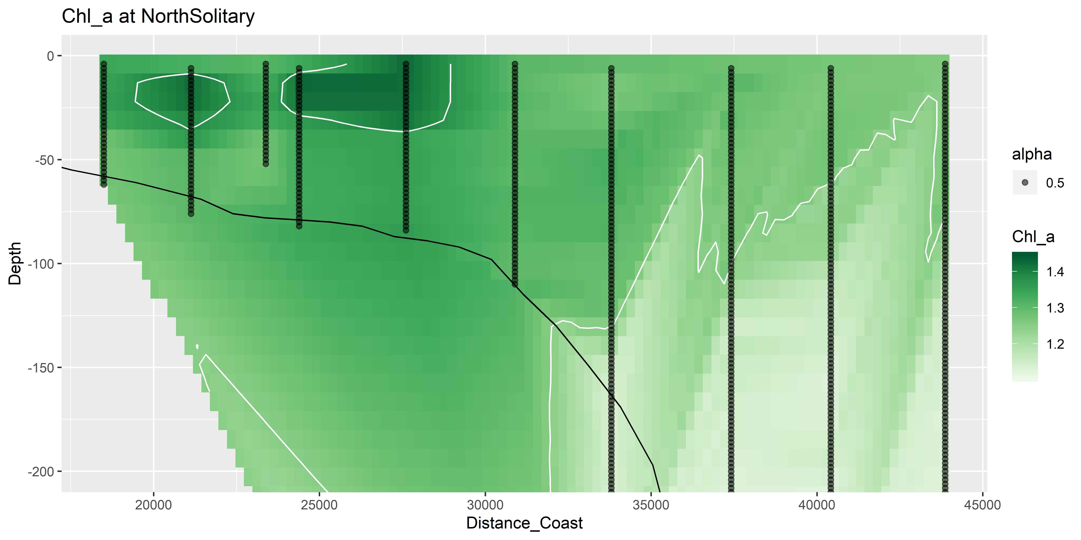
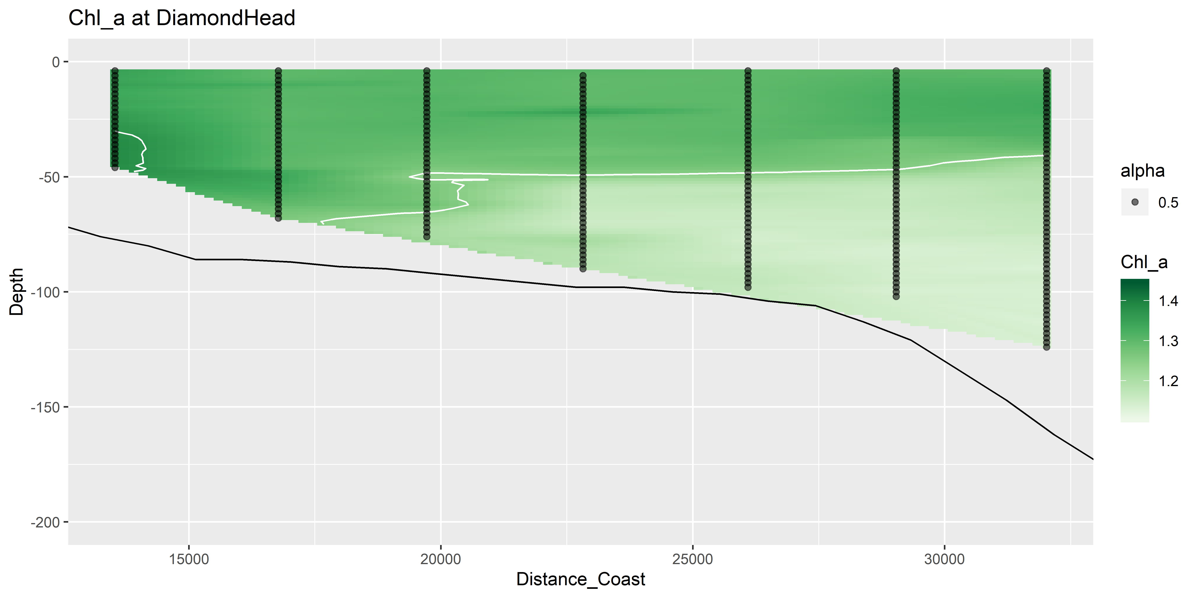
Chl_a top 200m

Slide 24



Nitrate

Slide 25



Silicate

Slide 26



Oxygen

Slide 27



Oxygen utilisation (top 200m)
um/kg
Positive = respiration (lower O₂)
Negative = photosynthesis / production
um/kg
um/kg

Slide 28



Salinity

Slide 29



Temperature

Slide 30

Zooplankton Biomass temperature contours

Slide 31




Zooplankton Biomass

Slide 32




NBSS Slope

Slide 33




Pareto Slope

Slide 34

Abundance

Slide 35




Abundance

Slide 36




Geometric Mean Size

Slide 37

Wind Stress

Slide 38

Modelling Zooplankton Biomass
Call: lm(formula = Biomass ~ Temp + Salt + Depth + site + Distance_Coast, data = mydata)
All variables significant except Salinity (P = 0.25)
Adj R² = 0.58
No autocorrelation taken in account ☹

Slide 39

Modelling Pareto Slope
Call: lm(formula = ParetoSlope ~ Temp + Salt + Depth + site + Distance_Coast, data = mydata)
All variables significant except Depth (P = 0.25)
Adj R² = 0.33
No autocorrelation taken in account ☹

Slide 40
Expectations
Areas of upwelling should have higher nutrients and plankton abundance
Areas offshore (open ocean water) should have slopes closer to -1
Southern sites should have higher biomass (colder water influence)

Slide 41
Patterns
Inshore North Solitary shows some upwelling + higher nutrients + biomass
North Solitary, Evans Head and Cape Byron have high surface biomass offshore (but not abundance?) – this is weird Data error
Abundance (and biomass) increases towards the shelf (I think this is common but relatively unpublished?)

